Slide 1
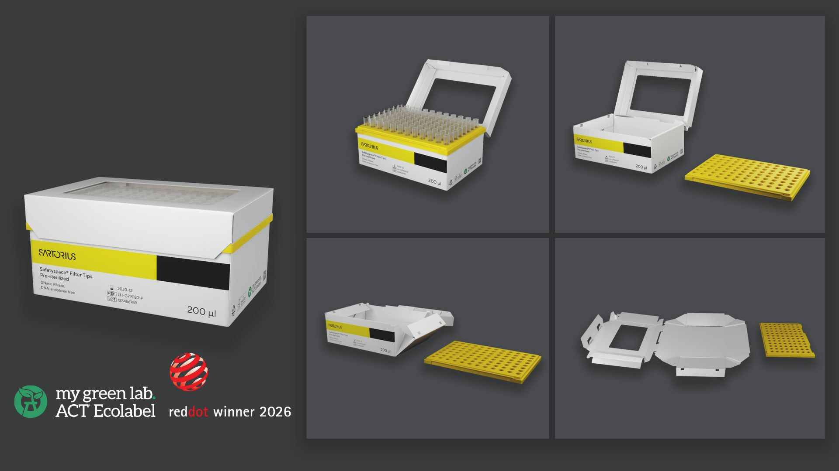
Light Pack
The Responsible Tip Box

Slide 2
Key Trends |
What Motivated Us

Slide 3
Sustainability as a driver
Demand for Sustainability
Labs are looking to reduce waste and carbon footprint.
Light Pack significantly reduces plastic use and supports established cardboard recycling streams.
Growing Focus on Scope 3 Emissions Reduction
Organizations are seeking ways to reduce supply-chain emissions and meet ambitious sustainability targets.
Light Pack reduces plastic consumption and carbon footprint while maintaining the performance, purity, and ease of use laboratories expect.
No Compromise on Performance
Customers still require purity and usability.
Light Pack maintains the performance standards required for demanding Pharma applications.
Increasing Environmental & Regulatory Focus
Organizations are preparing for future sustainability requirements.
Light Pack helps customers move toward lower-plastic laboratory workflows.
Sources: McKinsey.com ; FDA.gov ; Sila-Standard.com ; Biophorum.com

Slide 4
Introducing the Light Pack

Slide 5
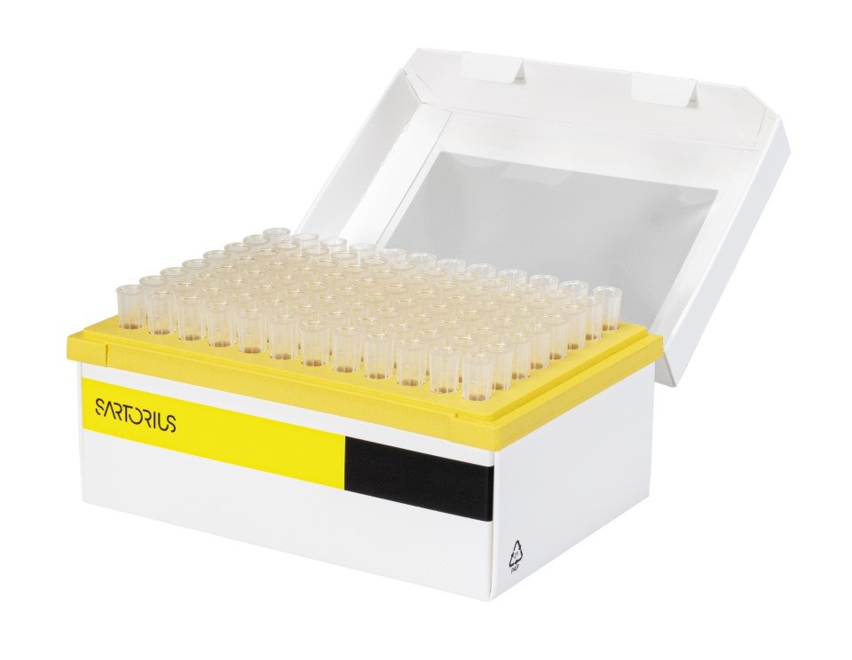
Discover the Light Pack, our cardboard pipette tip box, offering labs a sustainable choice without sacrificing quality. This recyclable, low-plastic alternative reduces environmental impact and minimizes waste, ensuring the same tip-picking stability as traditional plastic boxes.
The Responsible Tip Box

Slide 6
Key Benefits & Differentiators

Slide 7
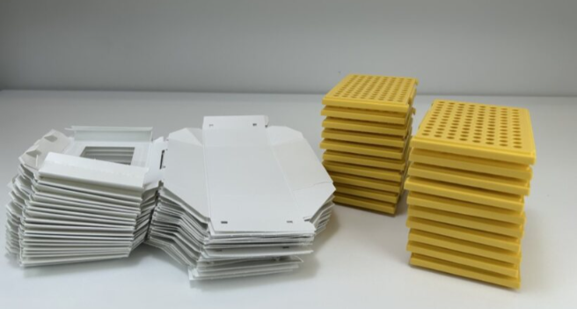
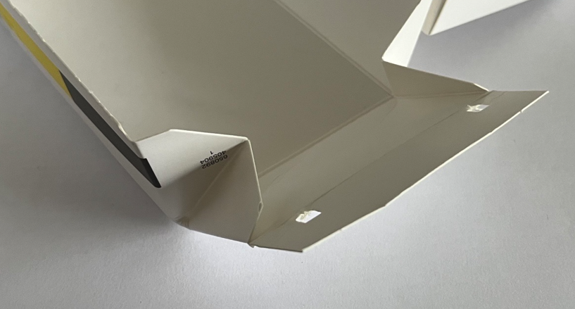
Features and Benefits
Optilid
Able to open and close the lid with one hand.
Foldable
Reduction in the volume of waste, lowering disposal costs
Window
Allows end users to see the number of tips in the box.
Cardboard box with Plastic Tray
Reduction in plastic content which contributes to sustainability practices
Robust & Rigid Design
Ensures stability during tip picking
Safety Corner
Cleanliness and reduces contamination risk

Slide 8
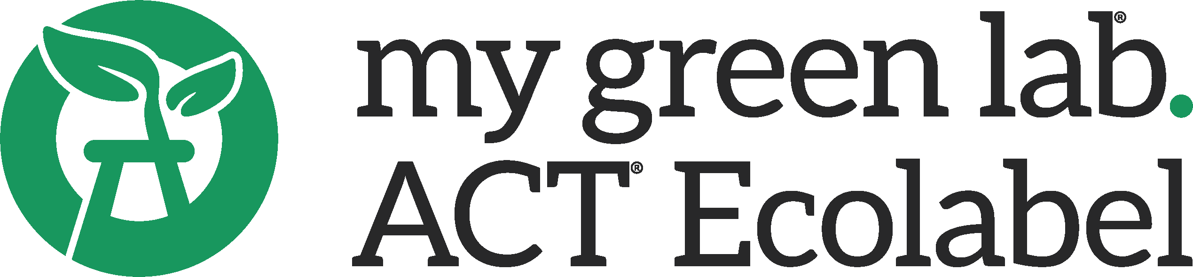

The Responsible Tip Box
Sustainability Facts & Certifications
74%
45%
50%
Reduction in plastic, compared to a standard tip box
Reduction in carbon, compared to a standard tip box (Cradle to Grave)
Reduction in waste volume, when the box is flattened.
Unfold. Flatten. Recycle
Recyclable paperboard through established recycling streams
FSC Certified Material
Recognised for combining usability and sustainability
Third-party verified sustainability claims and environmental impact

Slide 9
Portfolio

Slide 10
Volume | Purity Level | Tips/Unit | Order Code
200µl | Free of DNase, RNase, human DNA & Endotoxins | Optifit 10 x 96 | LH-G790200
200µl | Free of DNase, RNase, human DNA & Endotoxins Pre-sterilized | Optifit 10 x 96 | LH-G790201
200µl | Free of DNase, RNase, human DNA & Endotoxins Pre-sterilized | Safetyspace 10 x 96 | LH-G790201F
120µl | Free of DNase, RNase, human DNA & Endotoxins Pre-sterilized | Safetyspace 10 x 96 | LH-G790101F

Slide 11
Thank You.

