Slide 1

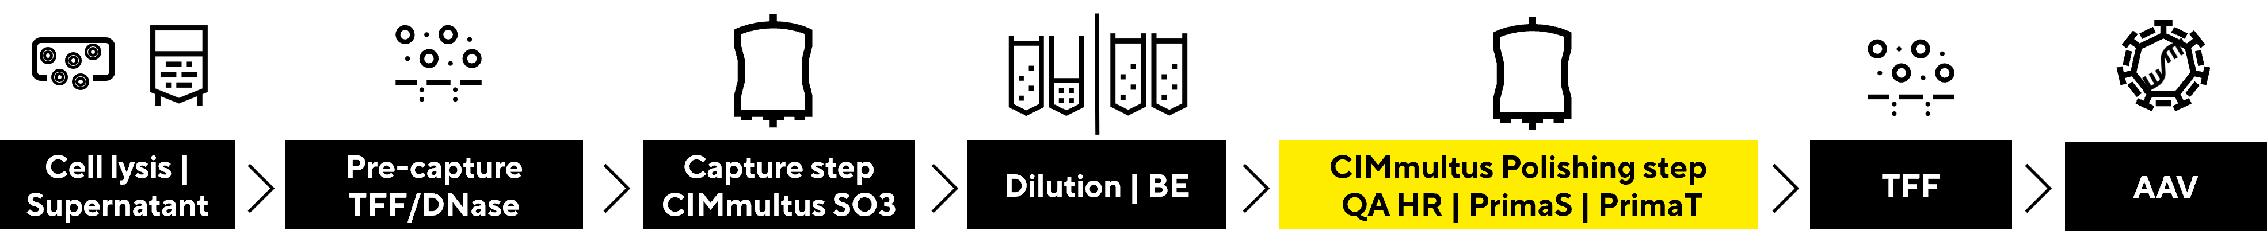
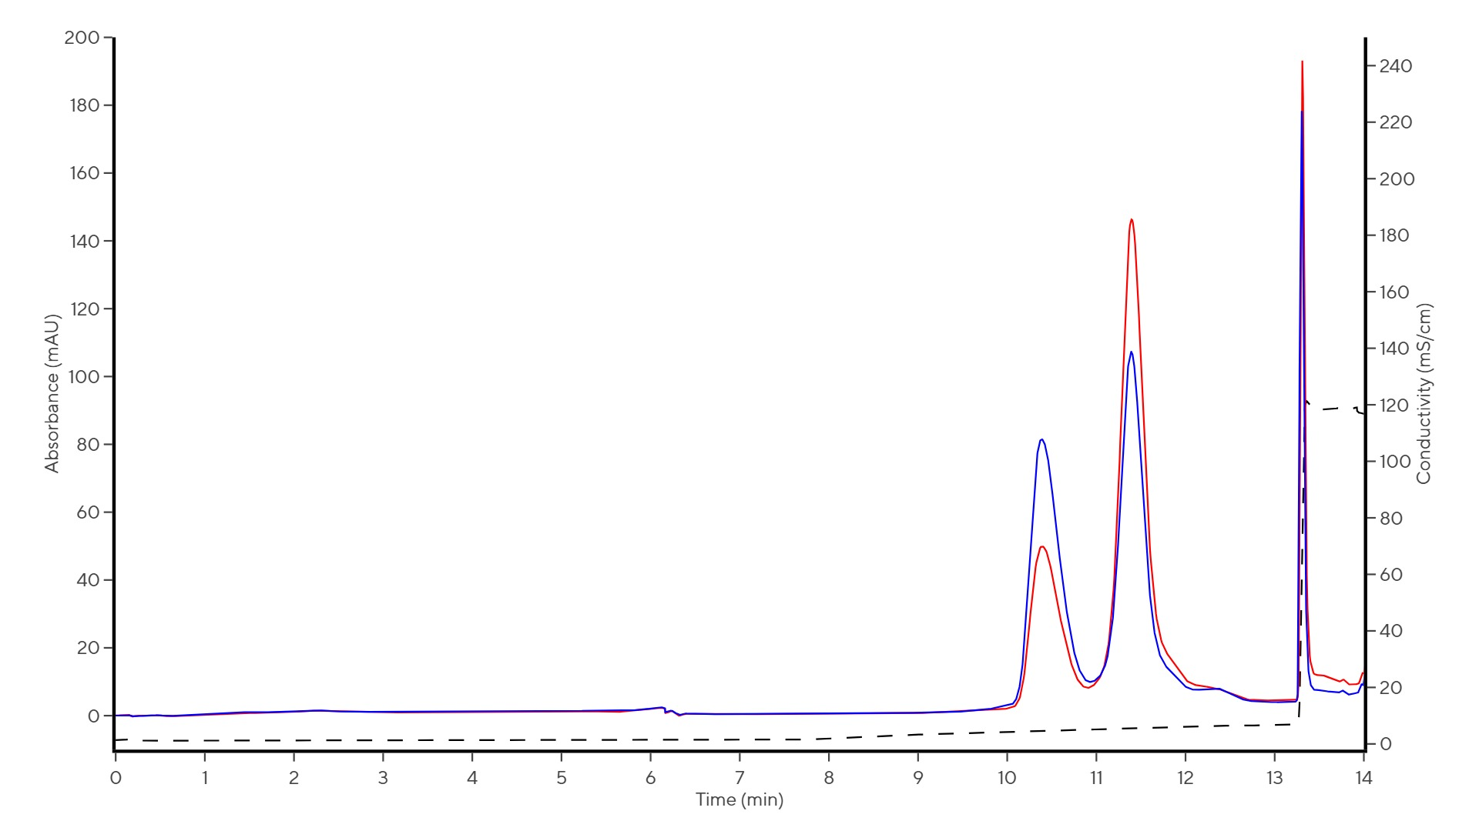
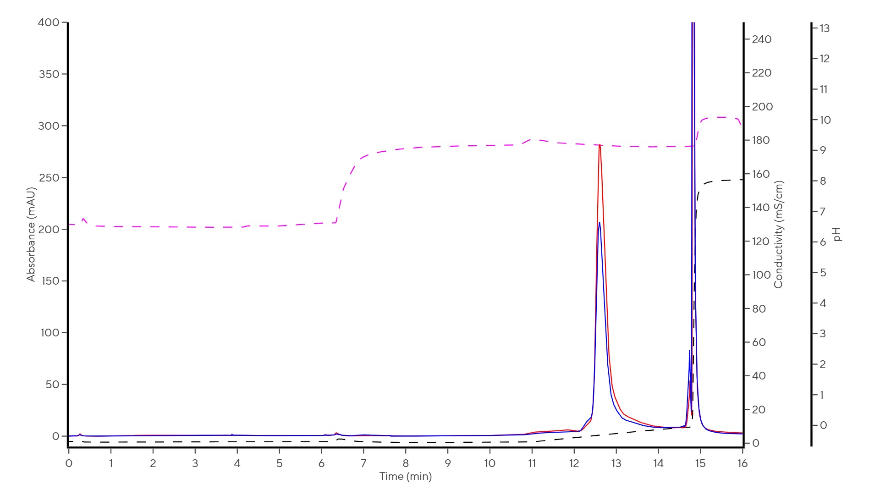
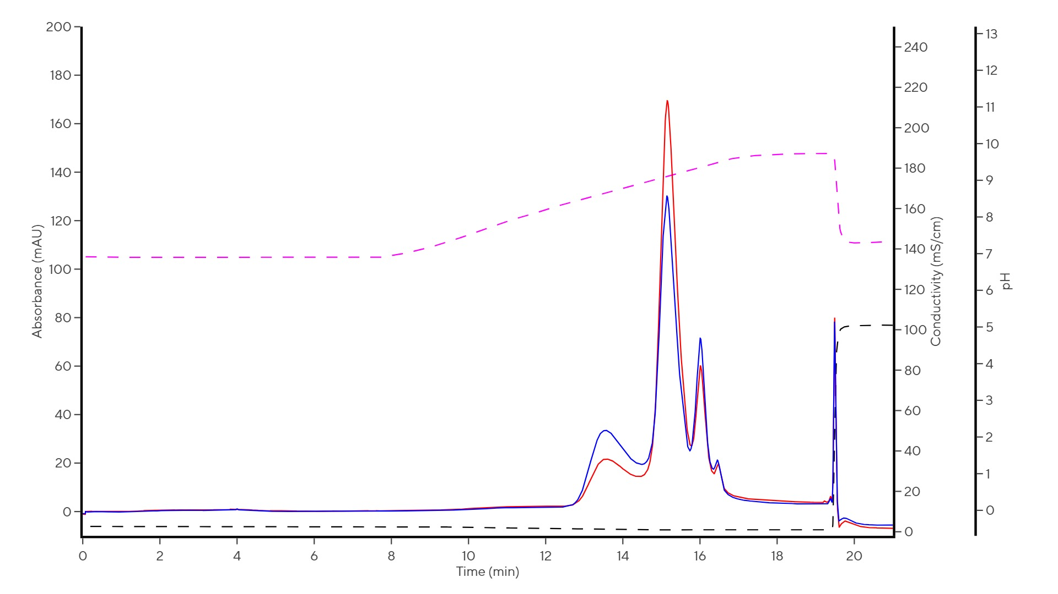
Optimizing AAV Purification: Comparative Evaluation of Three CIMmultus® Polishing Columns for Enhanced Vector Enrichment and Final Product Purity
J Merkelj Koren¹, S Drmota Prebil¹, M Štokelj¹, M Krašna¹, T Švigelj¹, K Kozjak¹, A Mihevc¹, R Žigon¹, M Leskovec¹, A Štrancar¹
¹ Sartorius BIA Separations, Ajdovščina, SI-5270, Slovenia
Corresponding author: janja.merkeljkoren@sartorius.com
Introduction
As the demand for high-quality AAV products increases, manufacturers face the dual challenge of ensuring both purity and efficiency in their processes. To evaluate and improve the polishing step following the capture phase in the AAV purification process, three monolithic polishing columns, CIMmultus QA HR, PrimaT, and PrimaS, were evaluated for their performance. The QA column acts as a strong anion exchanger, efficiently targeting negatively charged ions. PrimaS is a multimodal ligand that combines hydrogen bonding with anion exchange chromatography for versatile separations. PrimaT further enhances this versatility by offering weak-anion exchange, hydrogen bonding, and metal affinity coordination, making it suitable for complex molecular separations. While the QA HR column is already well-known in the biotechnology field, PrimaT and PrimaS are just beginning their journey. One of the key advantages of PrimaT is its ability to separate different subpopulations of full and empty capsids. PrimaS, on the other hand, distinguishes itself from the other two columns by utilizing a pH gradient, which can sometimes be the optimal choice for the polishing step. In this study, CIMmultus PrimaS was used as CIMmultus PrimaS HR was not yet commercially available; however, the same elution profile and purification performance are expected as with the standard PrimaS.
The primary objectives of this study were to examine and compare the results obtained from all three columns in terms of recovery rates, enrichment of full capsids in the main final fractions, and the removal of impurities, specifically total proteins and host cell DNA (hcDNA). The research was performed using AAV8, however, all three columns exhibit serotype-agnostic properties.
1. Experimental design
Downstream started with detergent lysis of cell culture in bioreactor. After clarification, main goal was to reduce host cell impurities in the process of pre-capture, where TFF/DNase was performed. Capture step was performed using a cation exchanger (CIMmultus SO3) in which rAAV8 was bound while most of the contaminants were removed. The main capture eluate fraction, with a titer of 1.01 E+13 vg/mL (3.53E+13 vp/mL) and containing 29% full particles (measured by Mass photometry (MP), SamuxMP, Refeyn), was further used for a comparative study involving three different polishing columns.
Figure 1: Schematic diagram of the Sartorius BIA Separations’ purification process
2. Polishing columns’ characteristics
Column | CIMmultus QA HR (strong anion exchanger) | CIMmultus PrimaT (multimodal weak anion exchanger) | CIMmultus PrimaS (multimodal weak anion exchanger)
Buffers | A: 20 mM Tris + 5 mM MgAc2 + 1% sorbitol + 0.1% poloxamer, pH 8.5 B: 20 mM Tris + 50 mM MgAc2 + 1% sorbitol + 0.1% poloxamer, pH 8.5 C: 20 mM Tris + 2 M KAc2 +0.1% poloxamer; pH 8.5 | A1 (loading sample): 25mM HEPES, 1% saccharose, 0.1% poloxamer 188, pH 7.0 A2 (pH transition): 50 mM Tris, 13.6 mM boric acid, 1% saccharose, 0.1% poloxamer 188, pH 9.0 B1 (elution): 50 mM Tris, 9.6 mM boric acid, 50 mM MgCl2, 1% saccharose, 0.1% poloxamer 188, pH 9.0 B2 (salt wash): 10 mM Tris, 2 M NaCl, 1% saccharose, 0.1% poloxamer 188, pH 8.5 | A: 10 mM TRIS, 10 mM BTP, 2 mM MgCl2, 1% saccharose, 0.1% poloxamer 188, pH 7.0 B: 10 mM TRIS, 10 mM BTP, 2 mM MgCl2, 1% saccharose, 0.1% poloxamer 188, pH 10.0 C: 0.5M TRIS + TRIS HCl, 1M NaCl, pH 7.5
Method | Elution: 100% B in 50 CVs; High salt wash: 100% C for 5 CVs | Elution: 0-100% B1 over 20 CVs; High salt wash: 100% B2 for 10CVs | Elution: 0-100% B over 50 CVs , hold at 100% B for 15 CV; High salt wash: 100% C for 10CVs
CIP solution | 0.1M NaOH + 2 M NaCl₂ | 1M NaOH + 2 M NaCl₂ | 0.1M NaOH
Effective pH | 2 – 13 | 6.5 – 9.5 | 7.0 – 10.0
Currently tested serotypes | Works on all serotypes | AAV 2, 3, 8, 9 | AAV 2, 8
Loading | At low conductivity
Binding capacities | Up to 5E+14 vp/ml column
Table 1: Comparison between three polishing columns.
3. Results: Chromatograms
CIMmultus QA HR
CIMmultus PrimaT
CIMmultus PrimaS
Figure 2: Chromatograms for each polishing column, with the main full elution fractions indicated in black. The red solid line represents UV260, the blue line represents UV280, the black dashed line indicates conductivity, and the pink dashed line corresponds to pH.
4. Results: Recovery, Full enrichment and Impurities removal
A
Figure 3: A) Recovery in main elution polishing fraction calculated to SO3 eluate analyzed by three different orthogonal analytics (dPCR, MP, PATfix AEX); B) Full enrichment in main polishing elution fractions measured by three orthogonal analytics (MP, PATfix AEX and UC-PATfix). C) % removal of protein impurities and hcDNA during the polishing step normalized to 1E+13 vg for all three columns.
5. Conclusions
The recovery on the polishing step is notably high and uniform across all three columns; the average results from the three orthogonal analytical methods are 87 % (QA HR), 84 % (PrimaT), and 82 % (PrimaS).
The full enrichment is consistent across all three columns, with both MP and UC-PATfix data yielding similar results (average 83 % for QA HR, 85 % for PrimaT, and 72 % for PrimaS).
The removal of hcDNA is most effective with the QA column, while protein removal is best achieved with the PrimaS column. The least effective impurity removal is observed with the PrimaT column.
Based on experience, each sample behaves differently, and the optimal polishing column may vary for each one. Therefore, conducting a screening of all three columns is advisable, as each column possesses unique characteristics.
© Sartorius BIA Separations 2025, all rights reserved
P_2025_17

