Slide 1
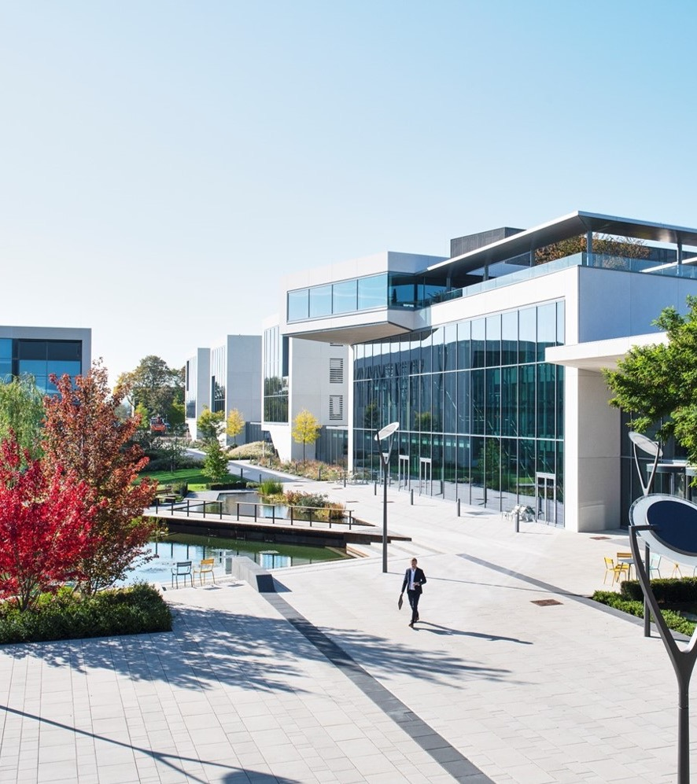
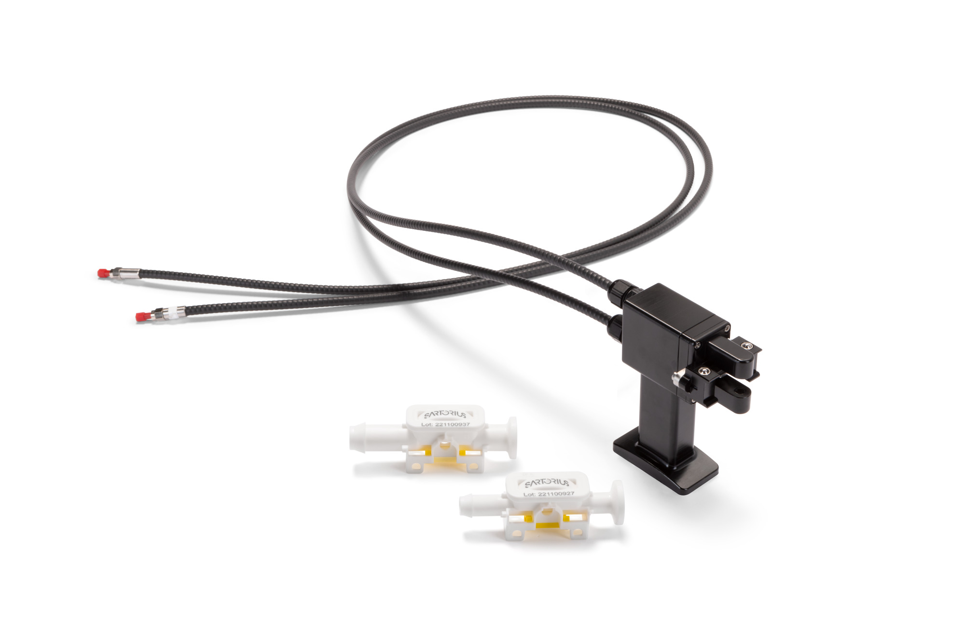

BioPAT® Spectro UV
Placeholder Image
Customer Presentation | March 2024

Slide 2
Agenda
BioPAT® Spectro UV Family
BioPAT® Spectro UV Use Cases | Resolute Flowdrive
BioPAT® Spectro UV Use Cases | Overcoming Signal Saturation
BioPAT® Spectro UV as Digital Solution
Ordering Information

Slide 3
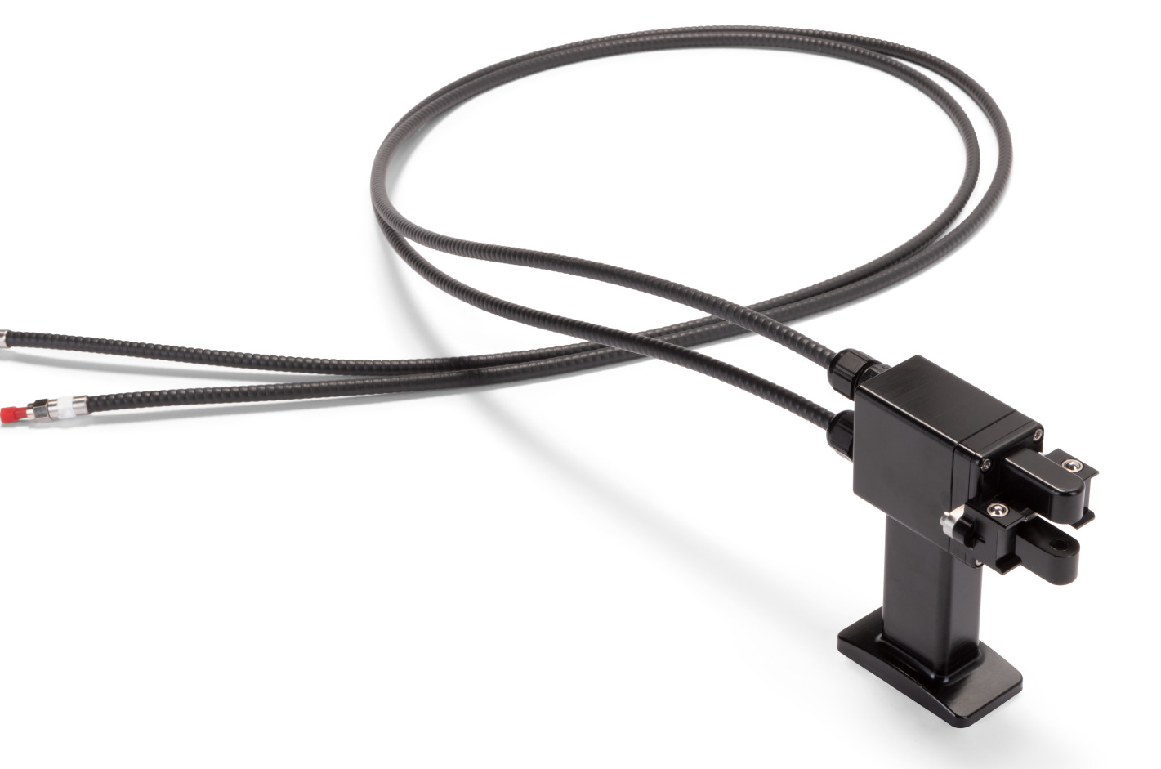
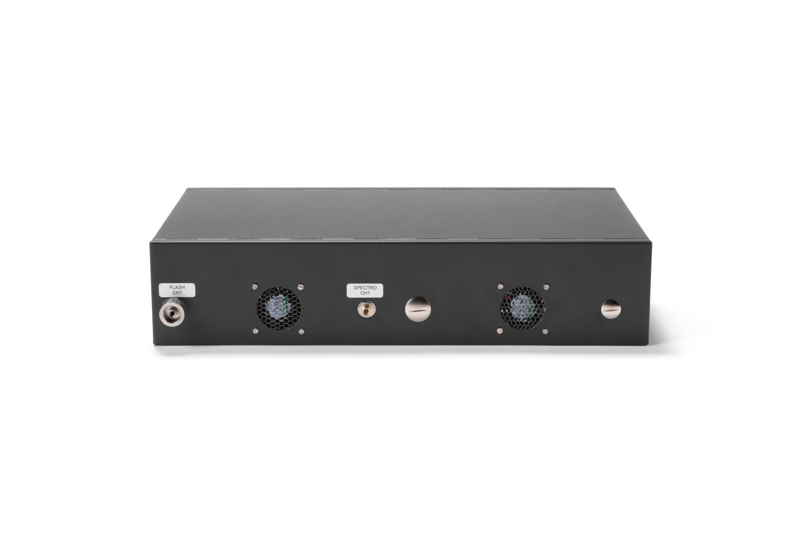
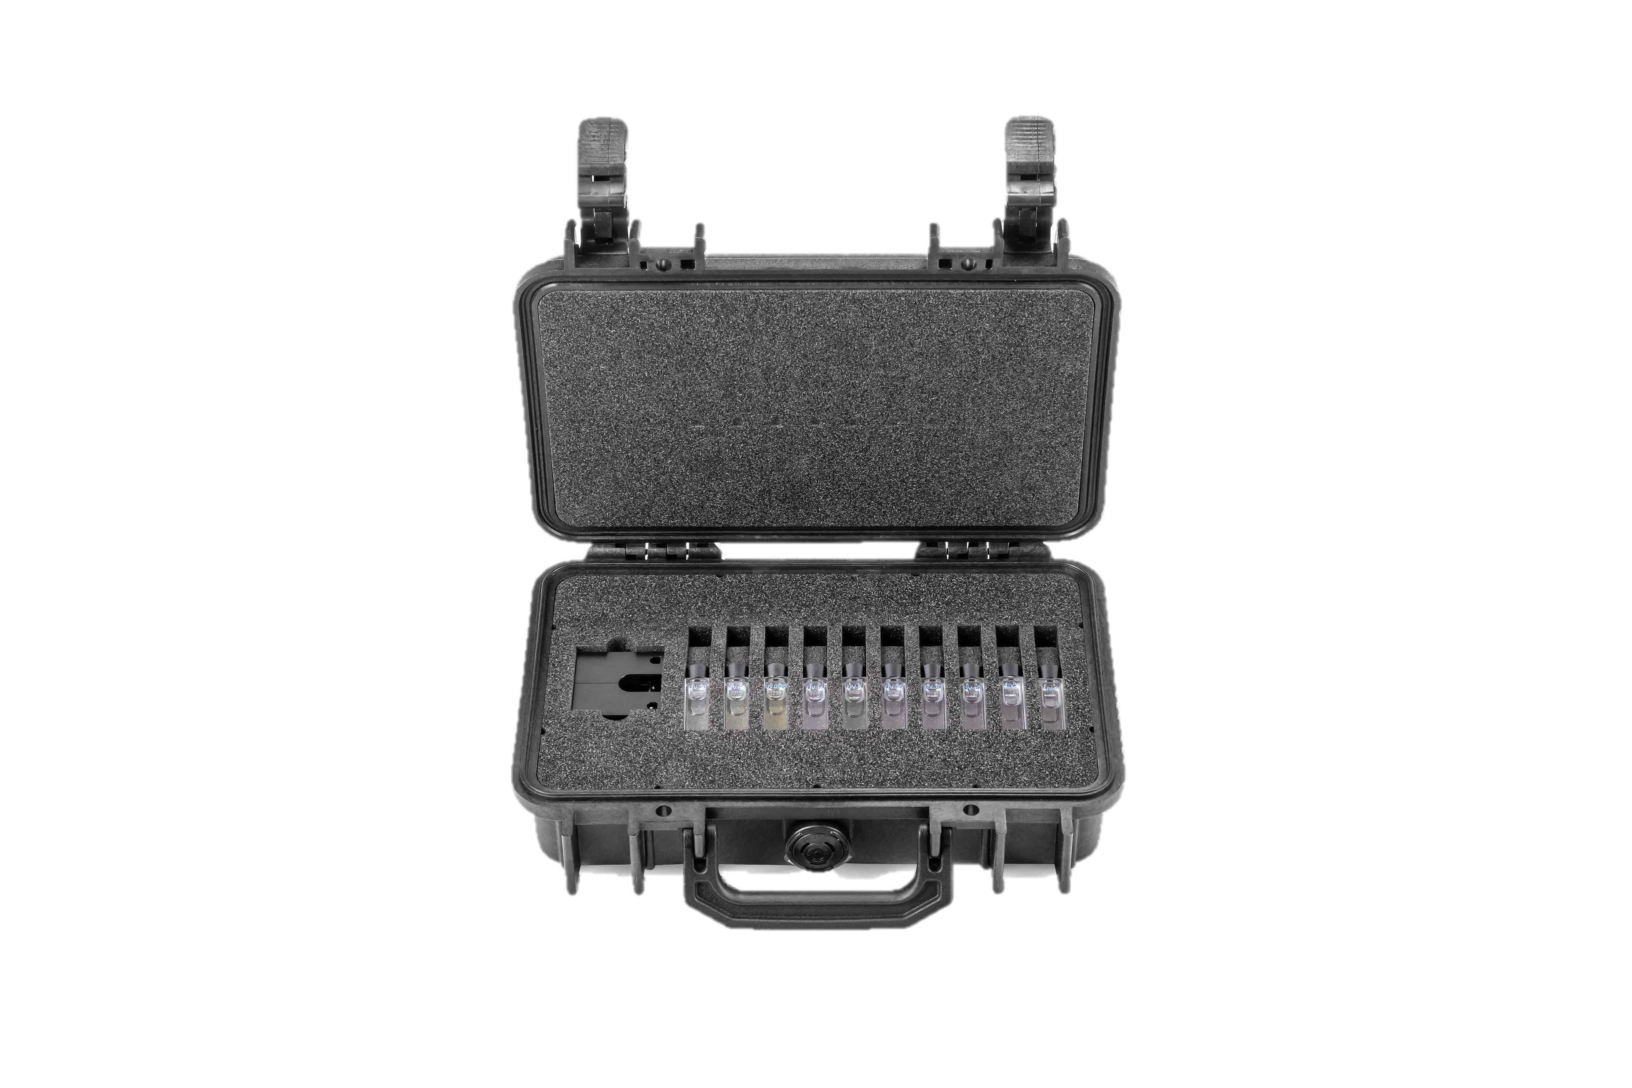
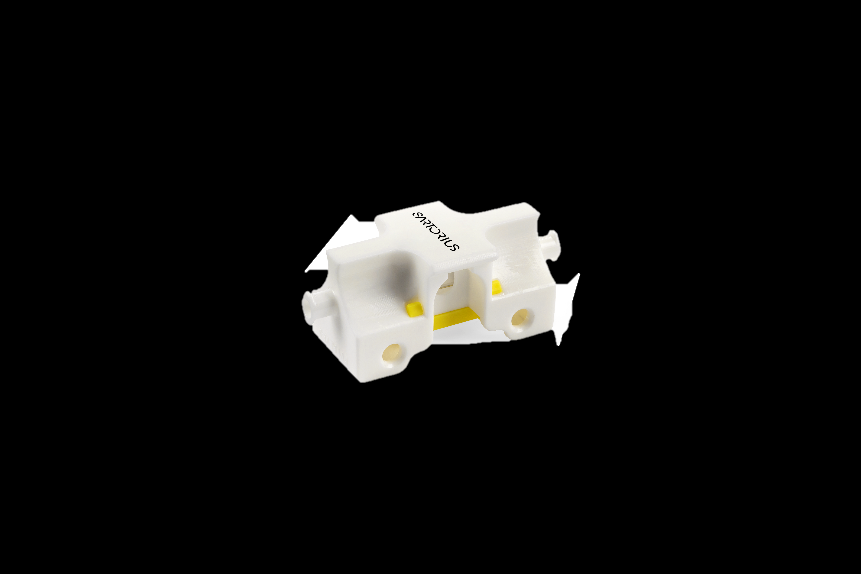
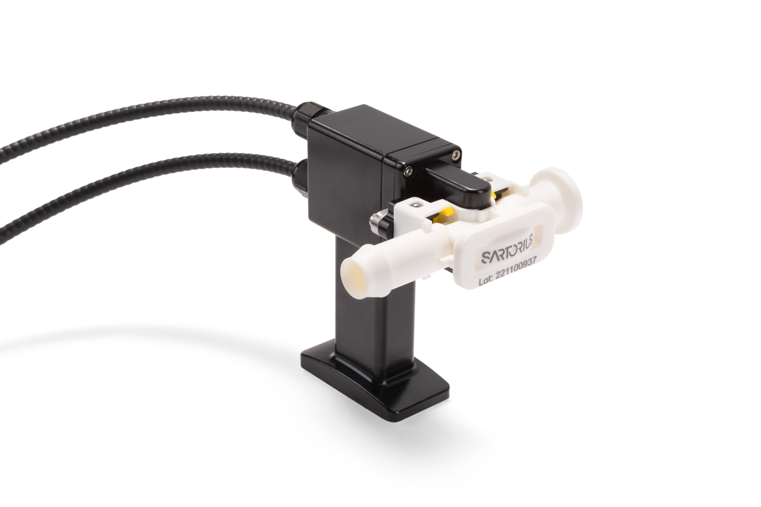
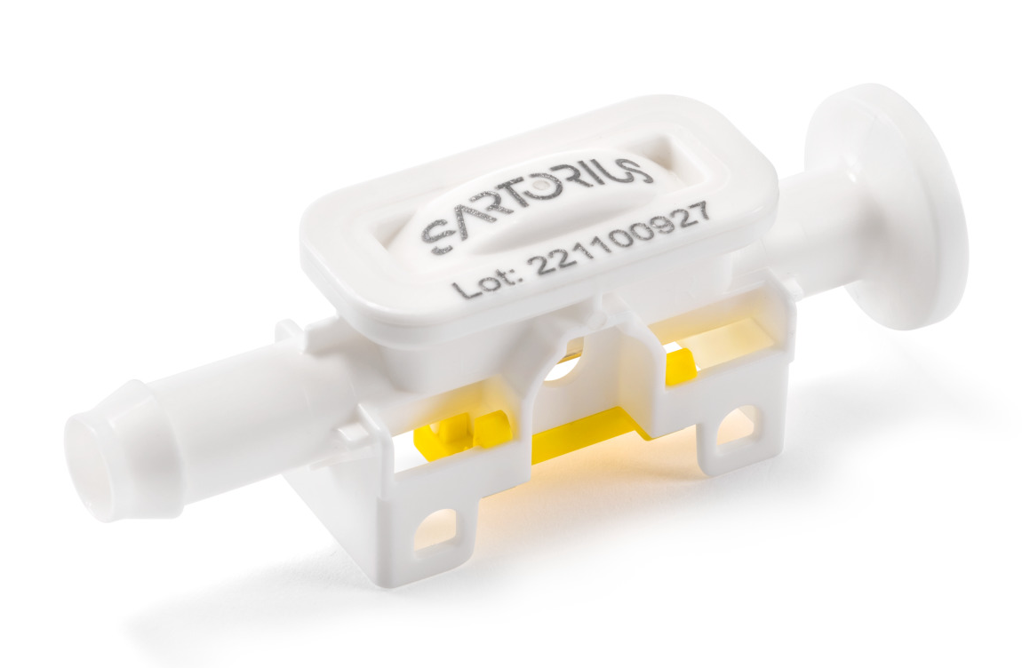
BioPAT® Spectro UV Combines High-Precision Consumables With a Superfast Light Source, and Meets Regulatory Demands
BioPAT® Spectro UV Family
Spectrometer
Probe Head
Probe Head + Spectro Pipe
Calibration Kit
Verification Kit
Single-Use Pipe
optional

Slide 4
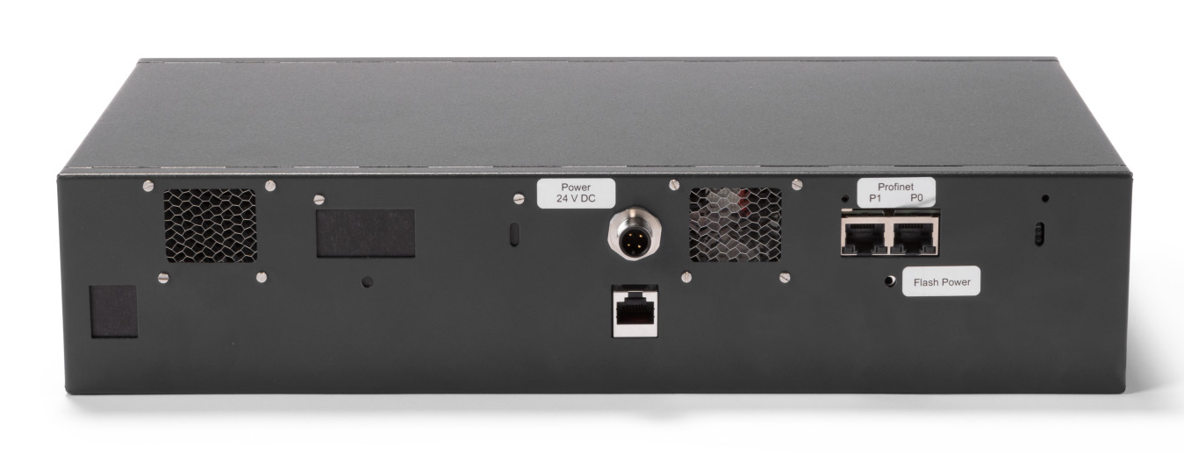
BioPAT® Spectro UV Enables Full Spectra Acquisition at High Frequencies, and Enables Multivariate Data Analysis
BioPAT® Spectro UV Family
1 Channel | 2 Channel Systems
Spectral Range 190-380 nm
both channels can work simultaneously and independent of each other
High light intensity provided by Xe flash lamp with individual flash correction
Lifetime monitoring of Xe flash lamp
High measurement frequency up to 10 Hz
PROFINET communication
Full spectra recording for use in MVDA, e.g. SIMCA
Embedded SIMCA-QPe enables multivariate concentration prediction
frontside
backside

Slide 5
BioPAT® Spectro UV Has One-Size-Fits-All Probe Head for All Available Single-Use Pipe Sizes and Variations
BioPAT® Spectro UV Family
One Probe for all SU pipe sizes and both accessories
Armored fibers 1.4 m (650 um diameter), non-rotatable
inert coating with proven chemical compatibility
IP54
Compact design assures a small footprint within integration
Fine alignment of optical components inside the probe head and the tight tolerances of quartz cell dimensions contribute to high reproducibility and comparability of the measurements

Slide 6
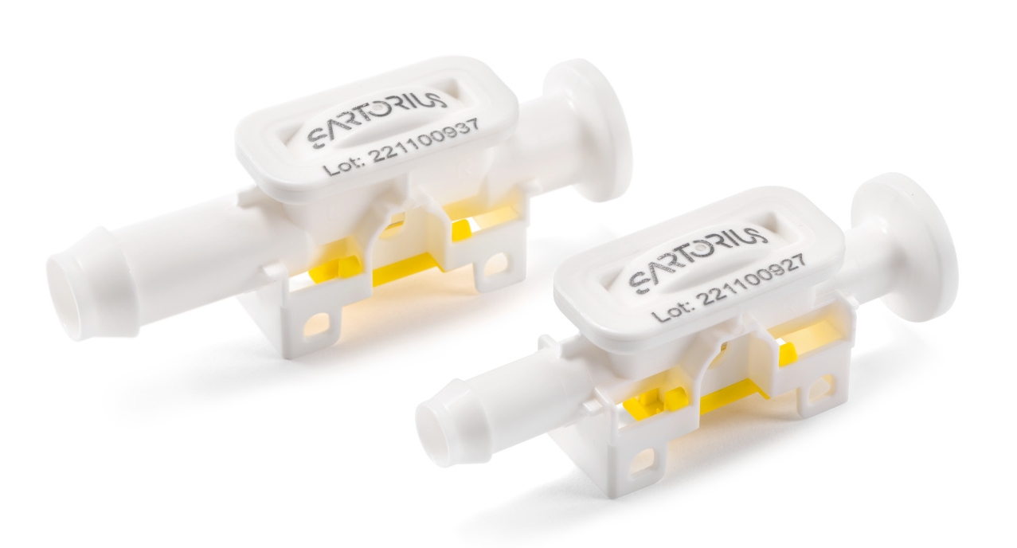
BioPAT® Spectro UV Single-Use Pipes – Functional and Optimized Consumable Design
BioPAT® Spectro UV Family
Single-Use pipe sizes 3/8“, ½“
Single-Use pipe variations: HB-HB, HB-TC
High chemical compatibility
Pressure range: 0 to 4 bar
Temperature range: +4 °C to +40 °C
Quantification of protein 0.05 to 10 g/L ± 1 g/L;
10 to 50 g/L ± 10% c.v.
LOD 0.05 g/L, LOQ 0.21 g/L
Smart pipe design ensures same optical pathway for all pipe sizes and variations. Thus, the comparability of measurement results over all pipe sizes and variations is given

Slide 7
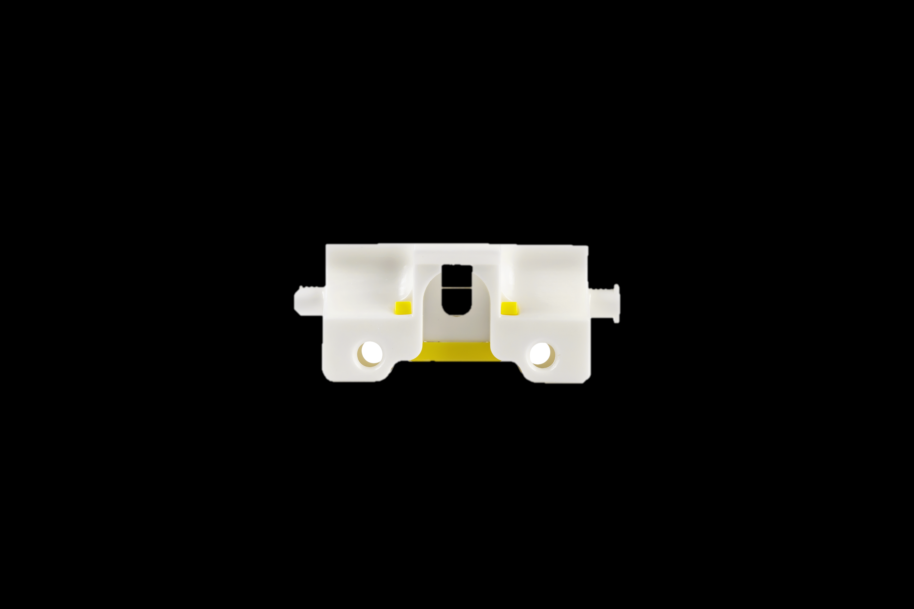
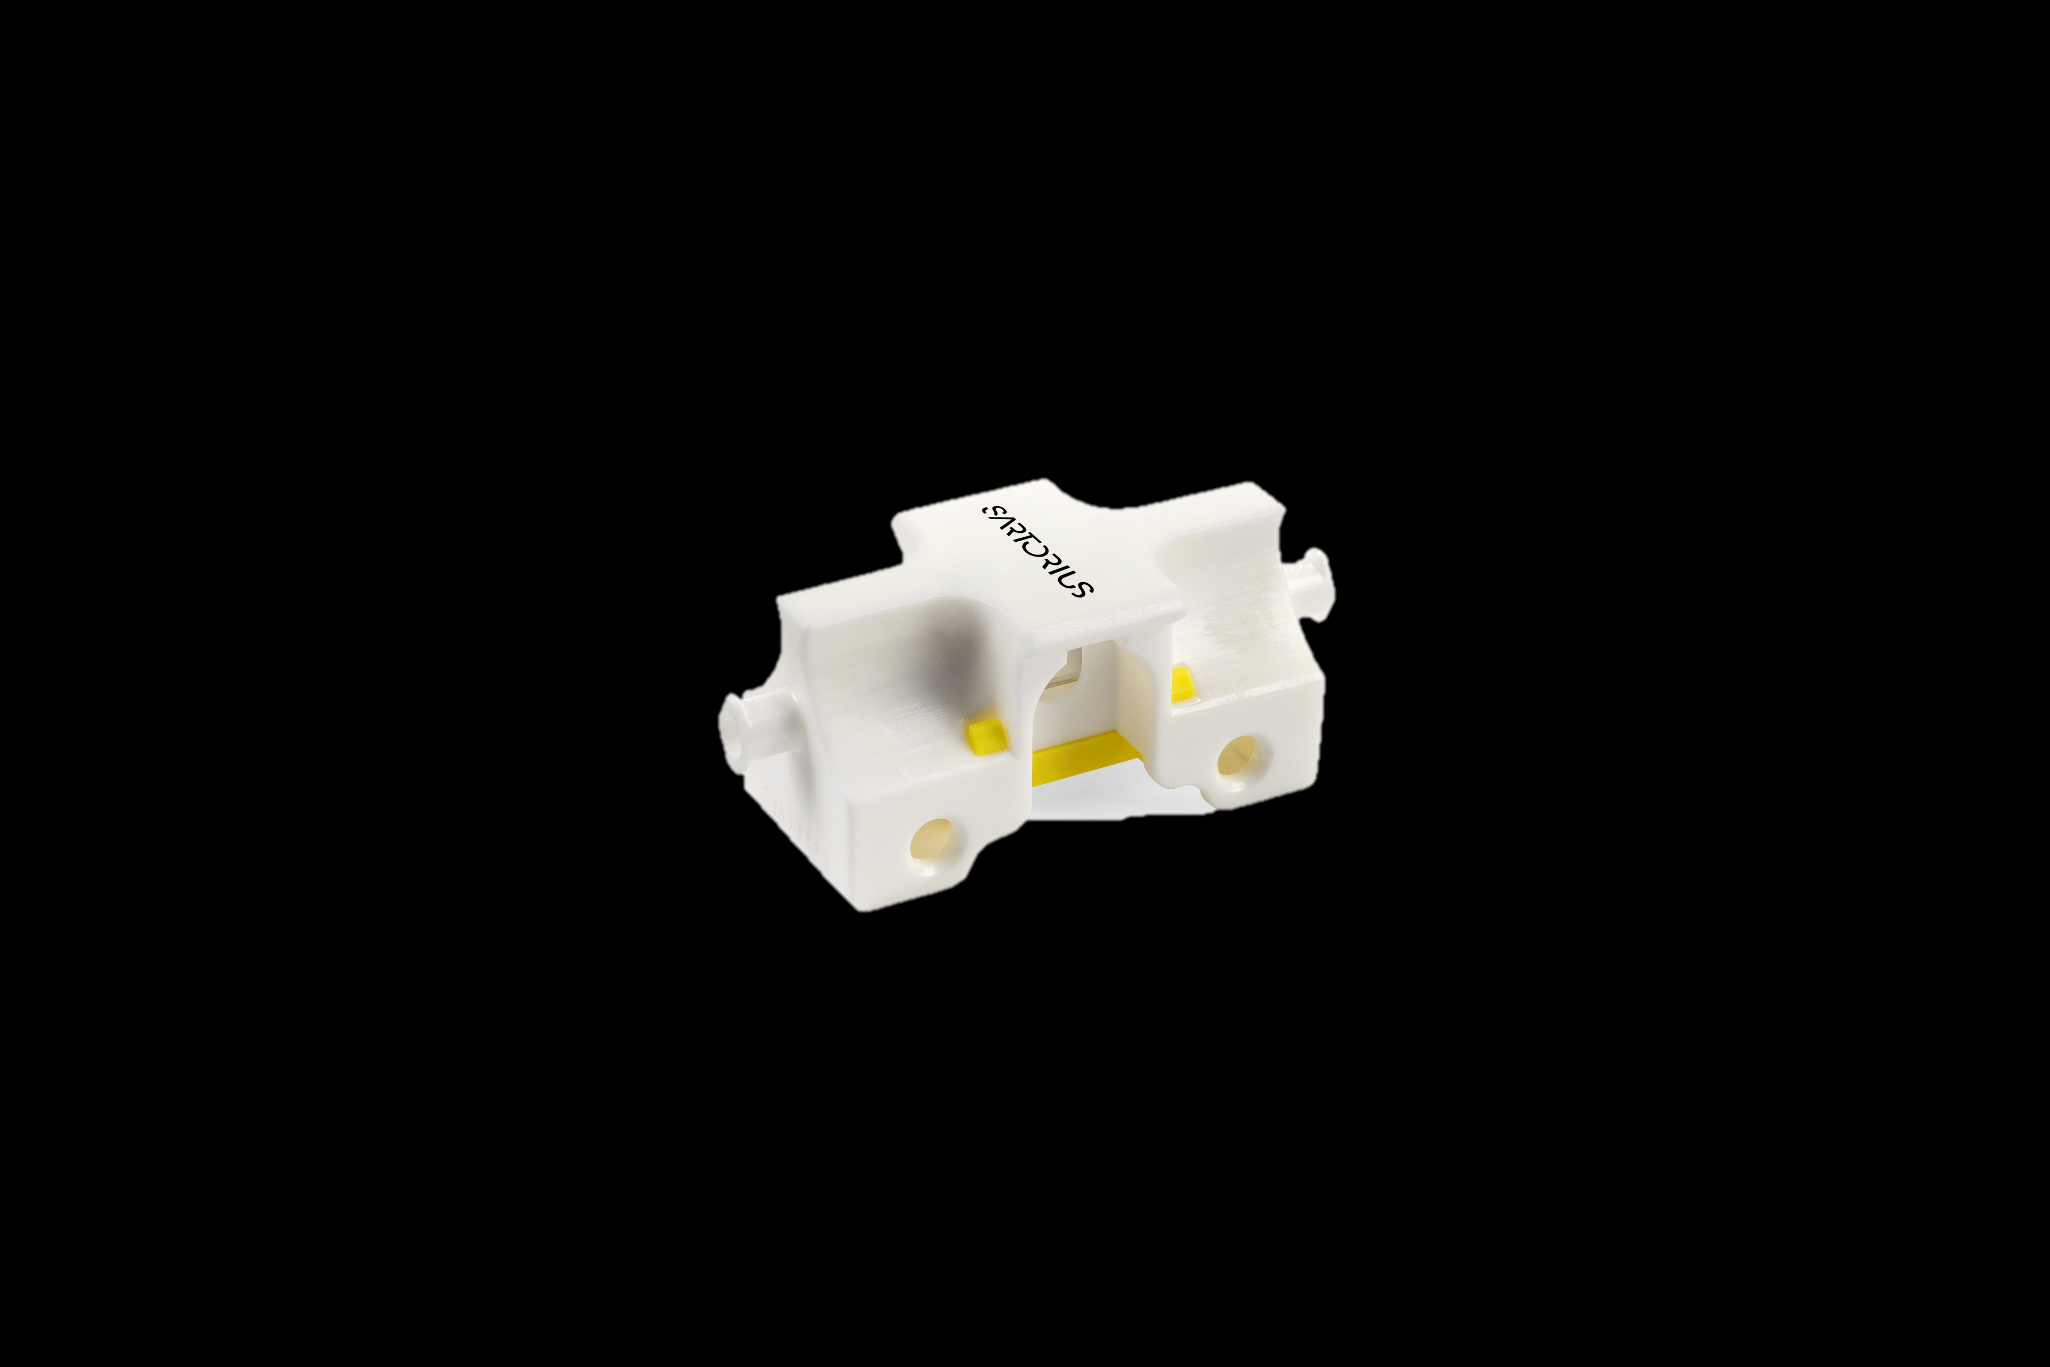
The Optional Calibration Pipes Enables Calibration Spectra Acquisition of Reference Solutions with Minimum Volume
BioPAT® Spectro UV Family
Calibration Pipe for offline model calibration, e.g. for univariate to multivariate model prediction
Multi-use, e.g. recommended to use for one calibration set
Two Luer-like connection for quick and easy loading and emptying
Very low volume of ~500 uL
Same optical pathway as for the SU FT pipes
3D printed MPU100

Slide 8
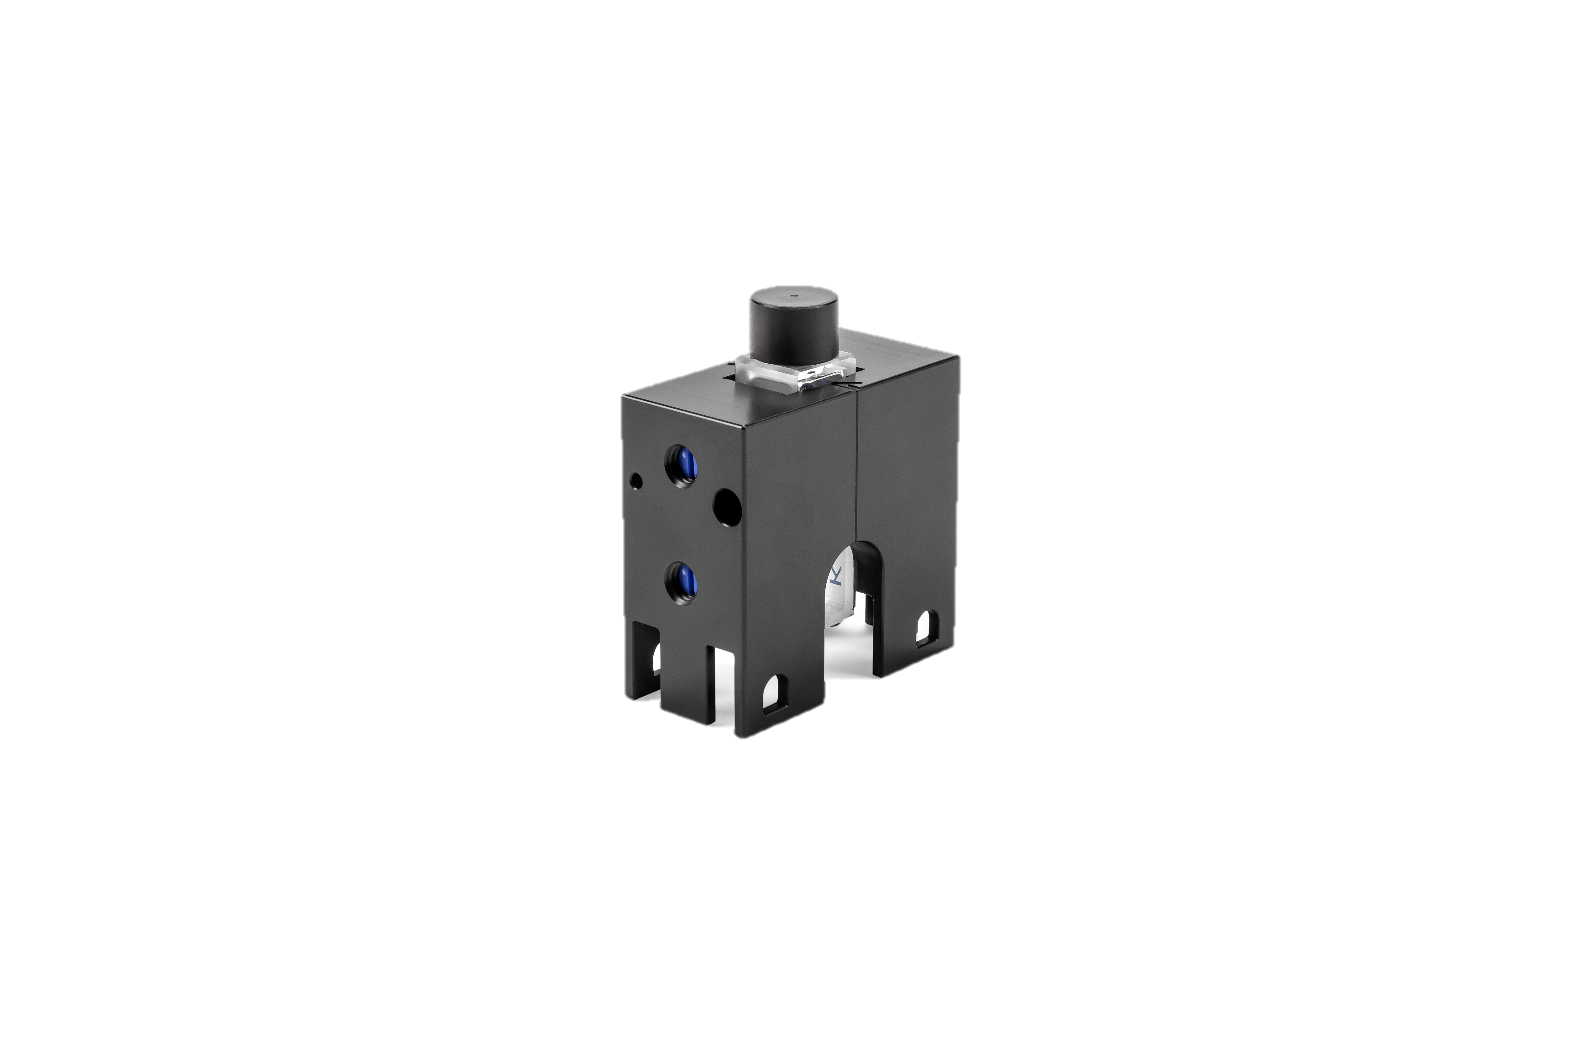
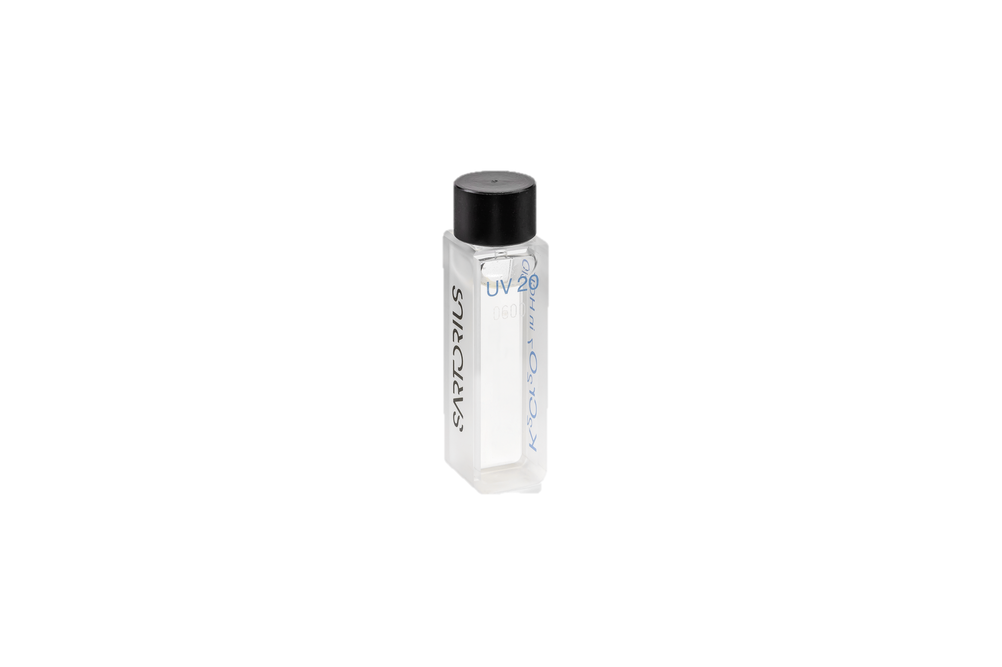
The Optional Verification Kits Offers a Set of NIST Traceable Standard Solutions for Check of Spectrometer Performance
BioPAT® Spectro UV | Family
Certified NIST traceable standard solution by analytical company Hellma with cuvette holder
Regulatory standards: Ph. Eur. 2.2.25* + USP** <857> fully applicable to benchtop UV-Vis instruments
Partially applicable for integrated UV-Vis instruments, e.g. HPLC detector elements
Regulatory demand:
  Control of wavelength accuracy
  Control of absorbance accuracy
  Control of photometric linearity
  Limit of stray light
  Control of resolution
* = European Pharmacopoeia ** = United States Pharmacopoeia

Slide 9
Proof of Concept at Resolute® Flowdrive SU Shows Protein Concentration during Bind-and-Elute Process
BioPAT® Spectro UV | Use Cases Resolute Flowdrive
2023-04-12 excel data.xlsx
Pre-column UV sensor
Post-column UV sensor
(column not shown on the picture)

Slide 10
Customer Use Case: Overcoming Signal Saturation in UF|DF Processes by Selecting the right Wavelengths of the Spectra
BioPAT® Spectro UV | Use Case- Overcoming Signal Saturation
Experimental setup:
      Initialization phase
      Diafiltration (DF) with buffer exchange
      Ultrafiltration (UF)
Results:
      Two separate linear regression models applied at 298 and 304 nm
      Inline values fit perfectly with offline analytic (SoloVPE)

Slide 11
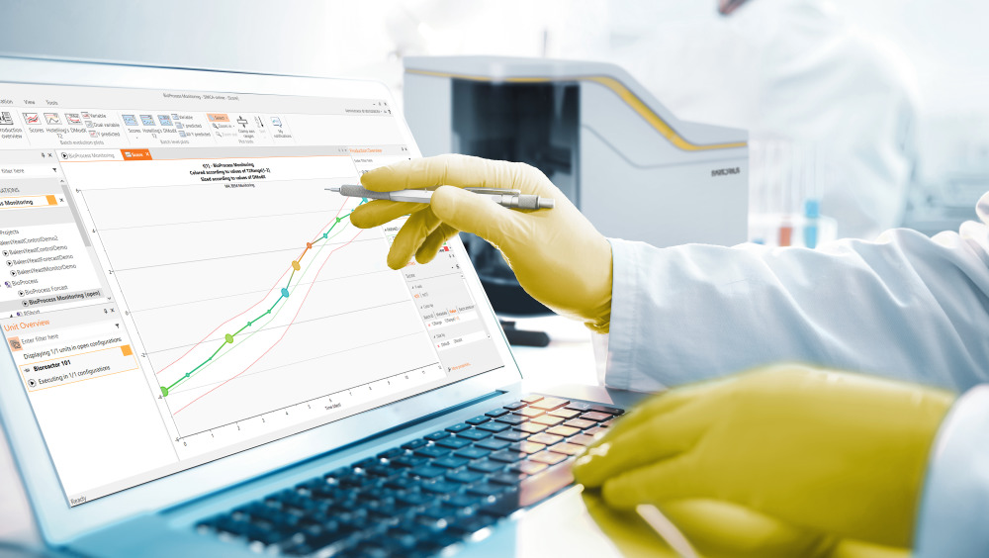
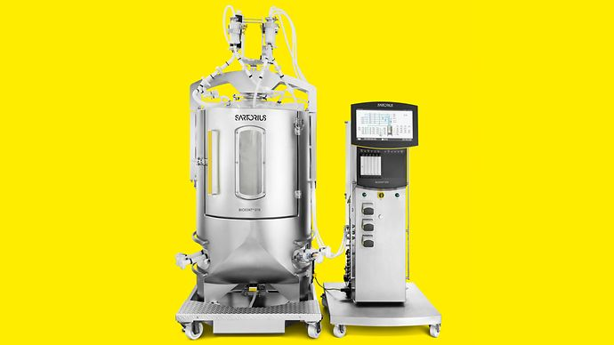
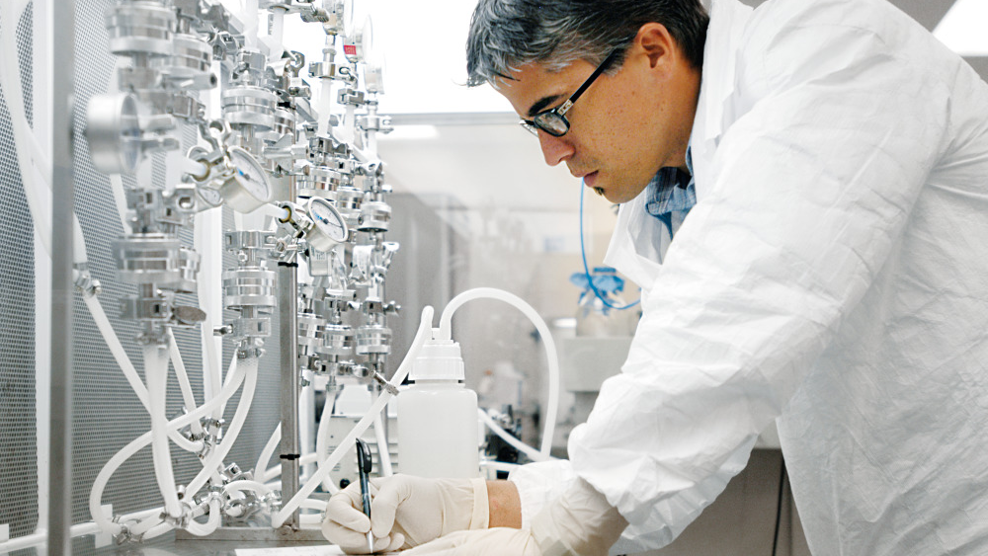
Unlock the Full Potential of BioPAT® Spectro UV in Combination with the Multivariate Data Analysis Software SIMCA®
BioPAT® Spectro UV as Digital Solution
BioPAT® Spectro UV offers Full Spectra Acquisition at High Pace
Overcome signal saturation and minimize the impact of impurities and noise with MVDA
Multivariate Data Analysis Software That Turns Data Into Growth
Free SIMCA® 2-months trials available with a loan BioPAT® Spectro UV device and remote training session
SIMCA®

Slide 12
BioPAT® Spectro UV | Ordering Information
Ordering Information
Material Description | Article Number
BioPAT® Spectro UV pipe* 3/8" HB-TC | BPS0321
BioPAT® Spectro UV pipe* 1/2" HB-TC | BPS0421
BioPAT® Spectro UV pipe* 3/8" HB-HB | BPS0331
BioPAT® Spectro UV pipe* 1/2" HB-HB | BPS0431
BioPAT® Spectro UV Spectrometer EC 1 Channel | BPS1110
BioPAT® Spectro UV Spectrometer EC 2 Channel | BPS1120
BioPAT® Spectro UV Probe | BPS1200
BioPAT® Spectro SU UV Calibration pipe | BPS1300
BioPAT® Spectro UV Instrument Verification Kit | BPS1301
Stand-Alone pack BioPAT® Spectro UV | BPS1302
*pipes are oderable in a pack of 10

Slide 13
Thank you.
Dr. Philipp M. Reintanz
Lead Scientist PAT
Phone +49 551 308 4507
Mobile +49 151 67548518
Philipp.reintanz@sartorius.com

