Slide 1

Quintix® Pro
Christian Weidner, April 2024

Slide 2

Quintix® Pro
Redefining the Standard

Slide 3

Notes:
Product teaser video.

Slide 4
Quintix® Pro
Redefining the Standard
Confidential
Notes:
With Quintix® Pro we will redefine the standard and we will set the new benchmark in the standard lab balance segment.

Slide 5
Value Proposition
Quintix® Pro laboratory balances deliver the performance you need, with added premium features that raise the bar in usability, flexibility, and eco-friendly design.
Redefining the Standard

Slide 6
Key Selling Points
Notes:
Main key selling points Quintix® Pro offers.

Slide 7









Key Selling Points
Quintix® Pro
Usability
Flexibility
Sustainability
Notes:
The marketing concept of Quintix® Pro is divided into three pillars.
We are focusing on usability, flexibility and sustainability.

Slide 8
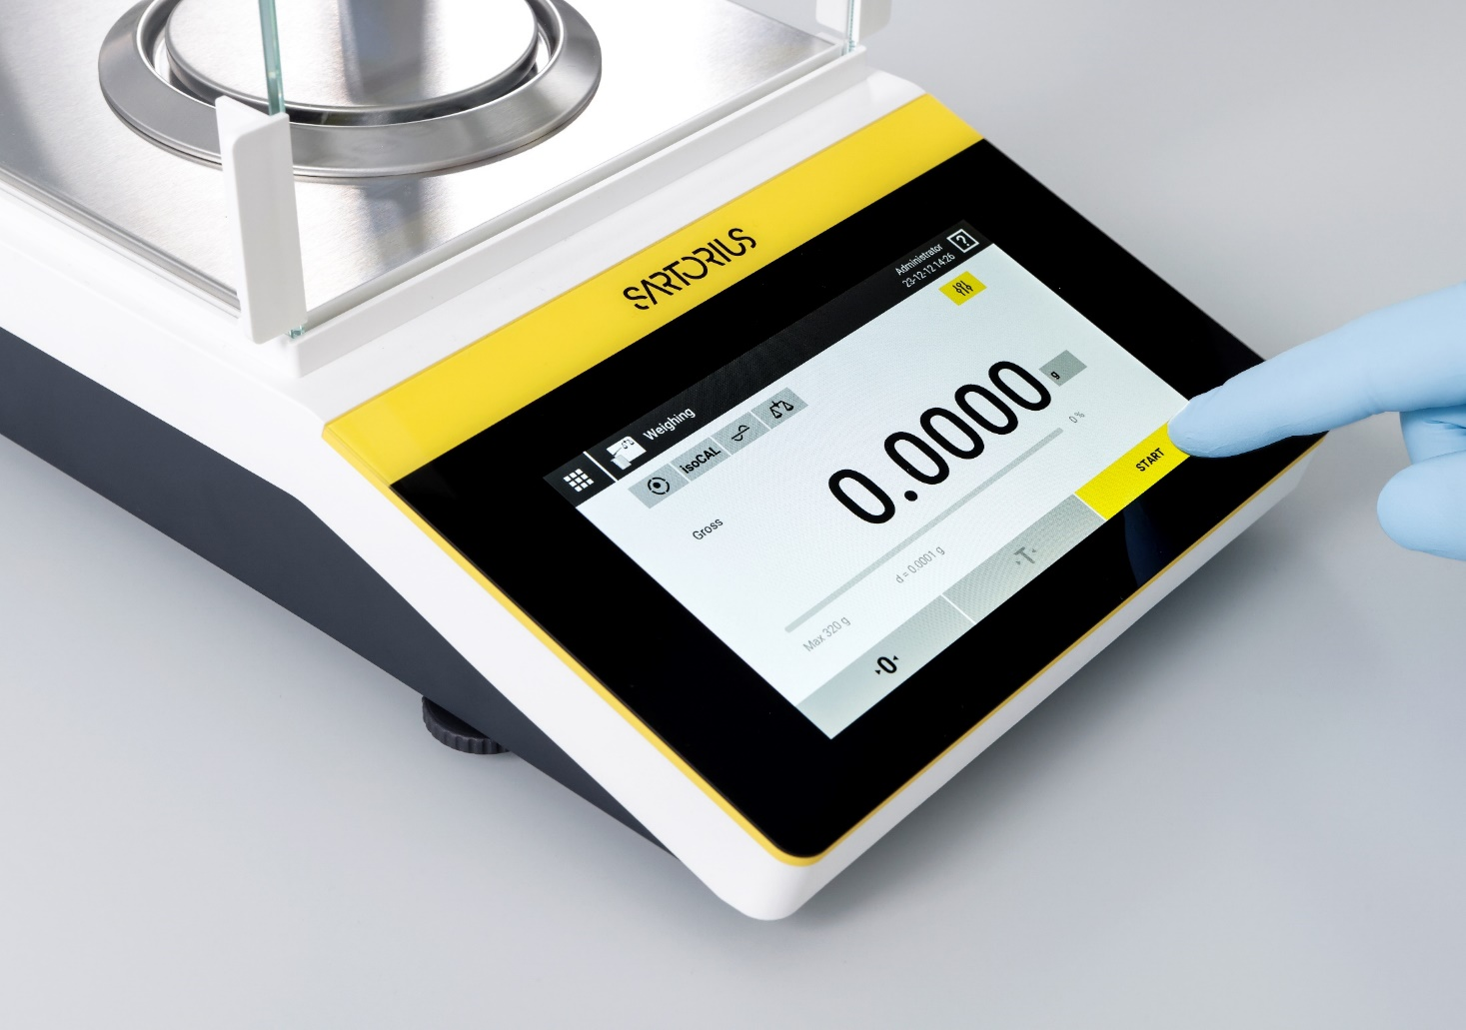
Key Selling Points
Usability
  7-Inch, High-Resolution full-touch graphic display with modern upgraded user interface
Notes:
Easy access to menu option with a large, 7-inch, high-resolution full-touch graphic display with modern upgraded user interface. The startup assistant allows quick and easy setup of the balance.

Slide 9
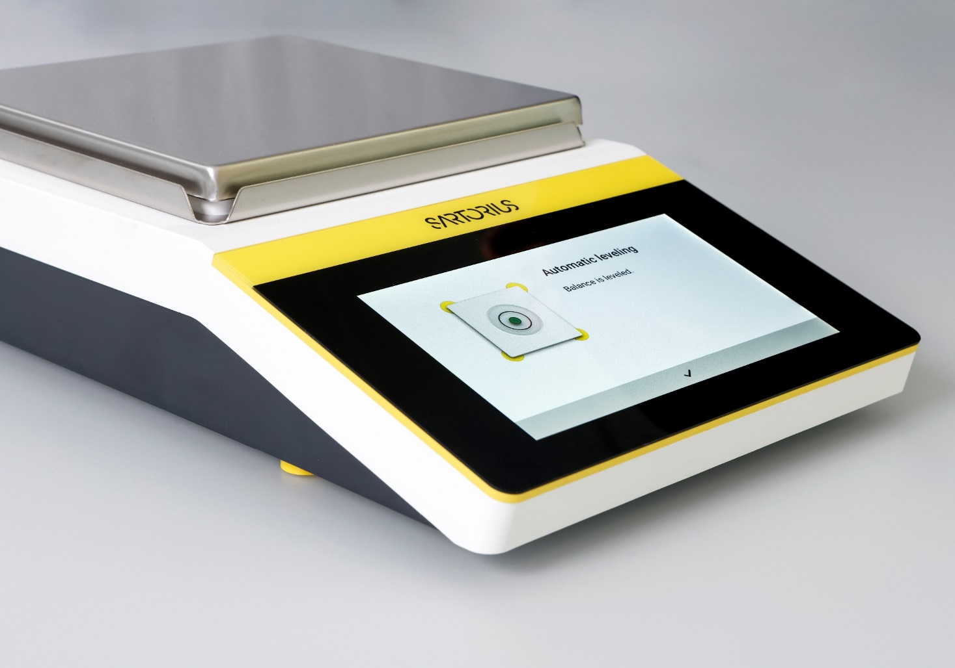
Key Selling Points
Usability
  LevelControl function guarantees a perfectly leveled balance at all time
  or
  Motorized Level Feet levels the balance fully automatically at the push of a button
Notes:
The LevelControl function of Quintix® Pro guarantees a perfectly leveled balance. It continuously monitors the level status in real time, instantly detecting any deviations. Should any tilt be detected, it responds immediately to safeguard your data: it will alert you and temporarily block data transfer to a printer or computer. Quintix® Pro will then guide you through the leveling procedure in real time.
With the Quintix® Pro LevelControl, you can rest assured that your measurements are completely accurate.
Leveling is even easier with the motorized feet. The Quintix® Pro levels itself fully automatically at the push of a button.

Slide 10
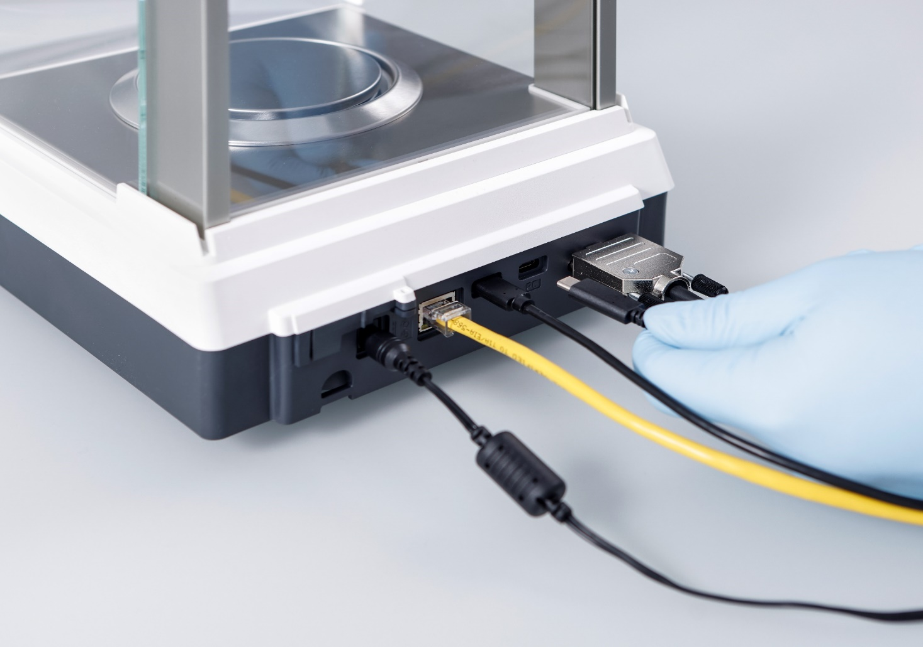
Key Selling Points
Usability
  Up-to-Date Interface Options (3x USB type C, Ethernet, backwards compatible with RS232)
Notes:
Be future ready! Quintix® Pro supports multiple connection to external devices via three USB type C interfaces, RS232 9-pin interface, and an ethernet interface. Transfer weighing data or calibration reports to a USB stick or directly to a database via the ethernet interface.

Slide 11
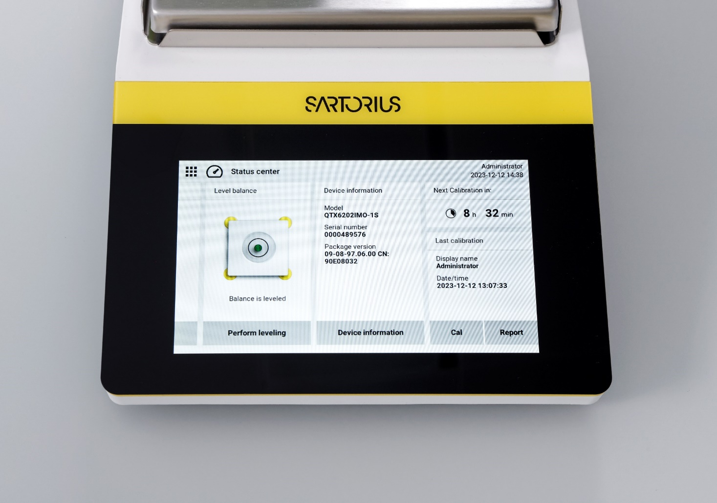
Key Selling Points
Usability
  Status Center provides the most important status information with just a single click
Notes:
The Status Center on Quintix® Pro provides a comprehensive summary of the balance's most important status information with just a single click.

Slide 12
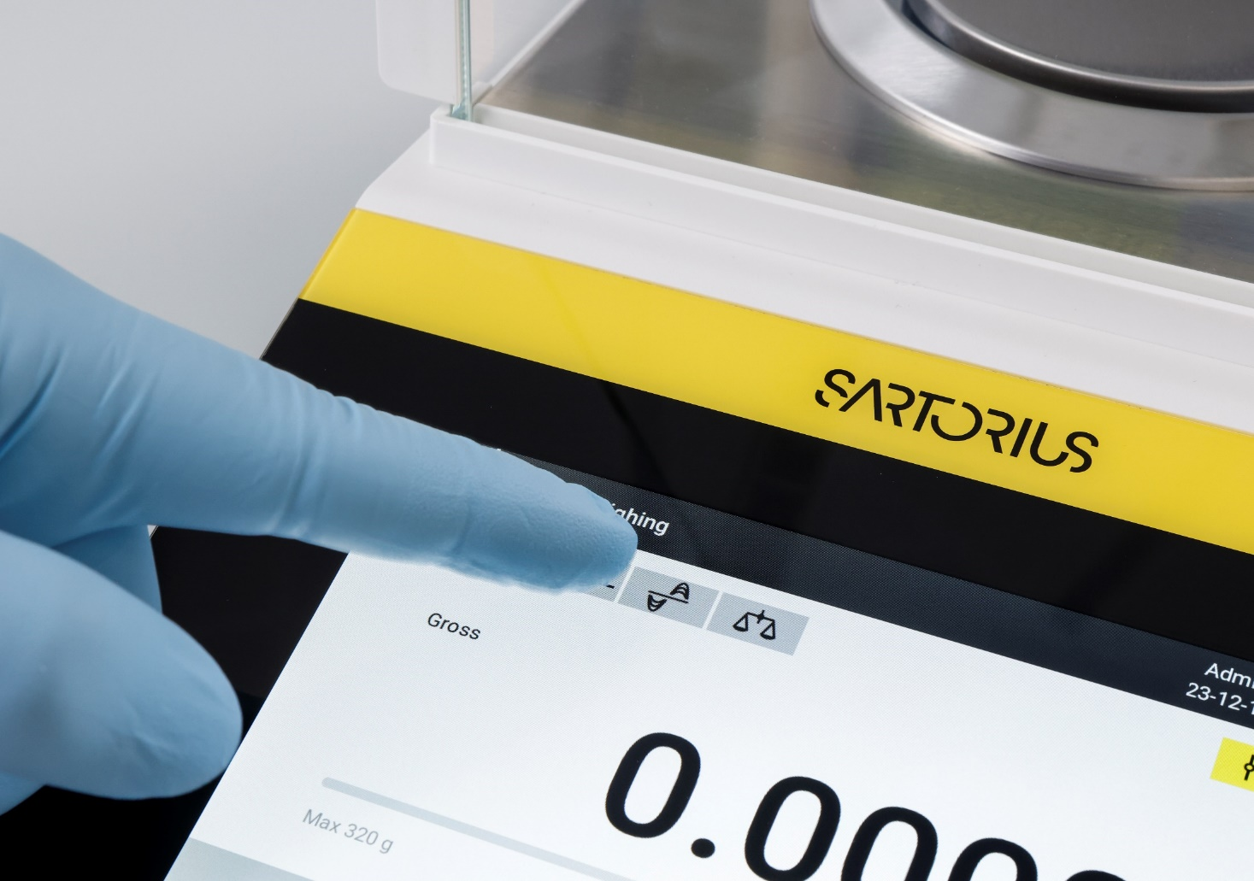
Key Selling Points
Usability
  Fast adaptation of balance performance to the unique needs of each application through the improved semi-automatic filter adaption (AFA)
Notes:
Whether your environment is stable or unstable, Quintix® Pro can be easily adapted to specific environmental conditions with just a single click.

Slide 13
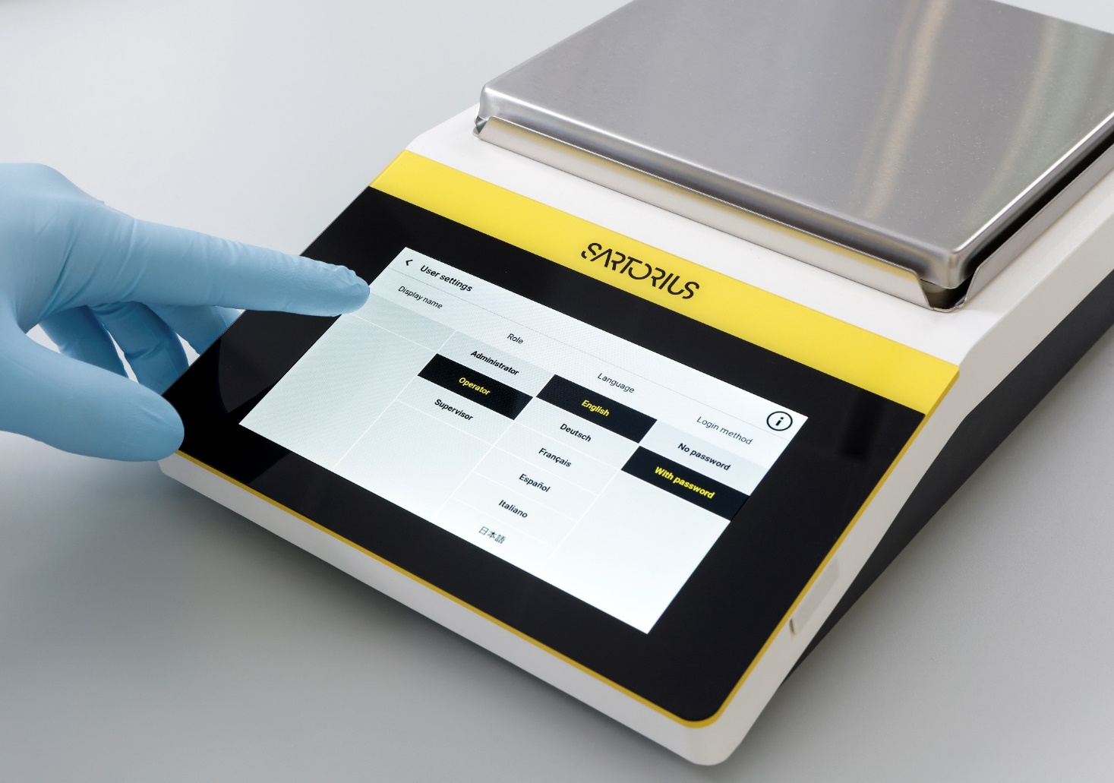
Key Selling Points
Flexibility
  User Management to assign individual roles to each user and customize them according to specific user needs
Notes:
The advanced user management system in Quintix® Pro enables you to assign individual roles to each user and customize them according to specific user needs. This feature allows Quintix® Pro to limit menu access strictly to authorized personnel, thereby providing comprehensive control and protection over your weighing procedures.

Slide 14
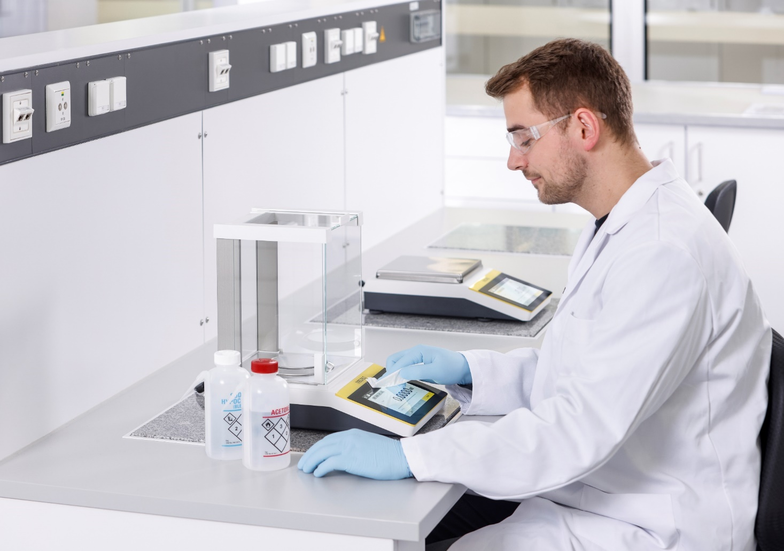
Key Selling Points
Flexibility
  Smart Design and Chemically-Resistant Surfaces enables an easy cleaning and prevents cross-contamination
Notes:
The contemporary design of Quintix® Pro facilitates easy and straightforward cleaning of the balance. The use of durable materials such as polybutylene terephthalate (PBT), stainless steel, and glass not only ensures high chemical resistance, but also prevents cross-contamination.

Slide 15
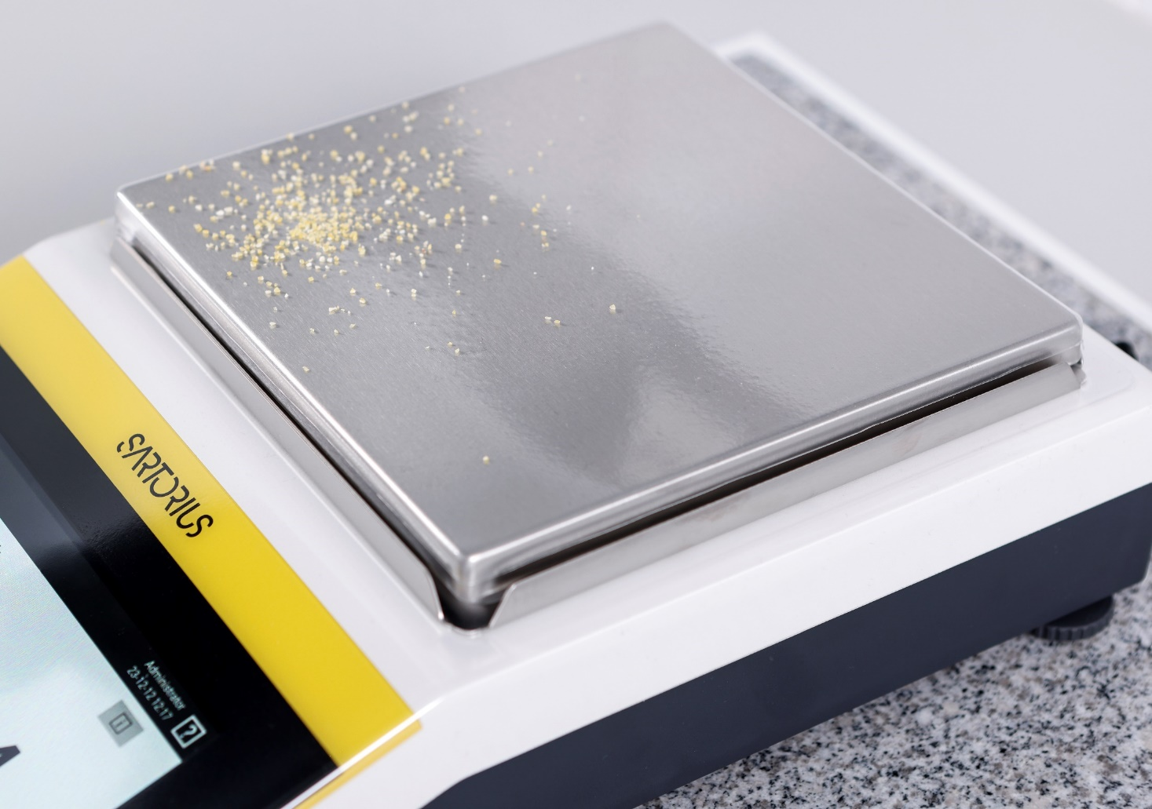
Key Selling Points
Flexibility
  Extended protection with In-Use-Cover and additional Protection Covers for the Weighing Pan and draft shield base plate are particularly useful in areas where hazardous materials are handled
Notes:
Enhance the protection of Quintix® Pro by utilizing an in-use cover. This cover envelops the entire housing of the balance, offering additional defense against contamination.
The additional protection covers for the weighing pan and draft shield base plate is particularly useful in areas where hazardous materials are handled.

Slide 16

Key Selling Points
Flexibility
  Tested for use in Cleanrooms, and Special Environments e.g., VHP® gassing process decontaminated rooms
Notes:
Application notes showing e.g., the performance will be available soon.

Slide 17

Key Selling Points
Flexibility
  15 integrated Application Programs and an extended language package with 15 Language Options makes it a truly universal balance that is suitable for any environment
Notes:
The combination of user-friendly design and diverse integrated application programs make Quintix® Pro a truly universal balance that is suitable for any environment:
Weighing | Dosing, Mass unit conversion, Counting, Percentage weighing, Calculation, Mixing, Components, Density determination, Statistics, Check weighing, Animal weighing, Peak hold, Pipette smart check, Differential weighing, Underfloor weighing.
With 15 available language options (Chinese, Czech, Dutch, English, French, German, Hungarian, Italian, Japanese, Korean, Polish, Portuguese, Russian, Spanish, Turkish), the Quintix® Pro is the perfect fit for any lab.

Slide 18

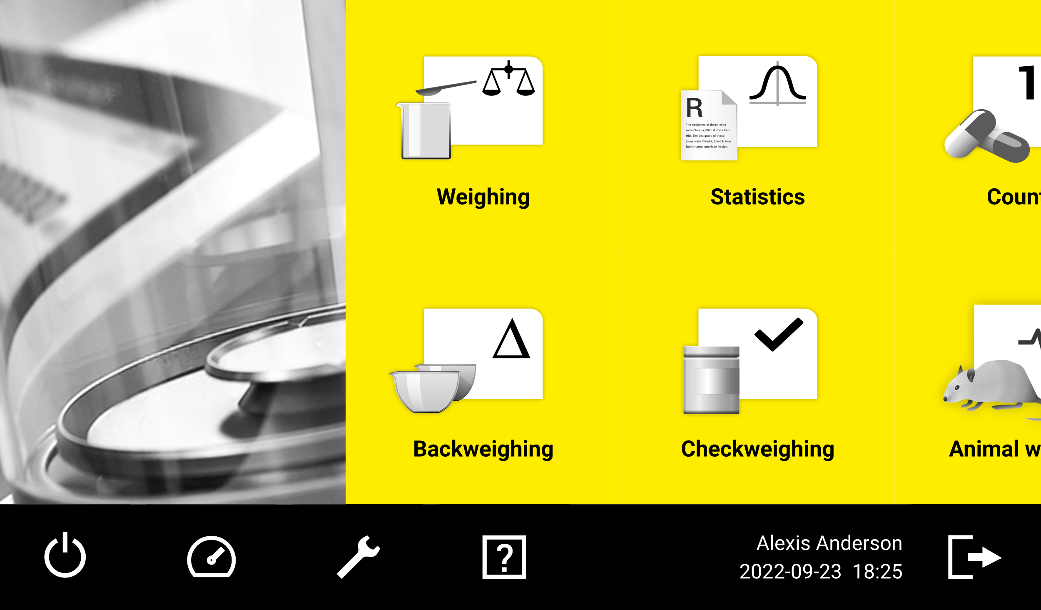
Key Selling Points
Sustainability
  Power-saving operation modes with Stand-by or Switch-off the balance
  and Automatic Dim Function, to reduce power consumption
Notes:
Last, we are talking about key selling points supporting the sustainability aspect.
Power-saving operation with stand-by (click on the icon) or switch-off (hold the icon for 3 seconds) modes.
Automatic dim function (time can be customized), reduces display brightness when balance is not in use to save power.

Slide 19
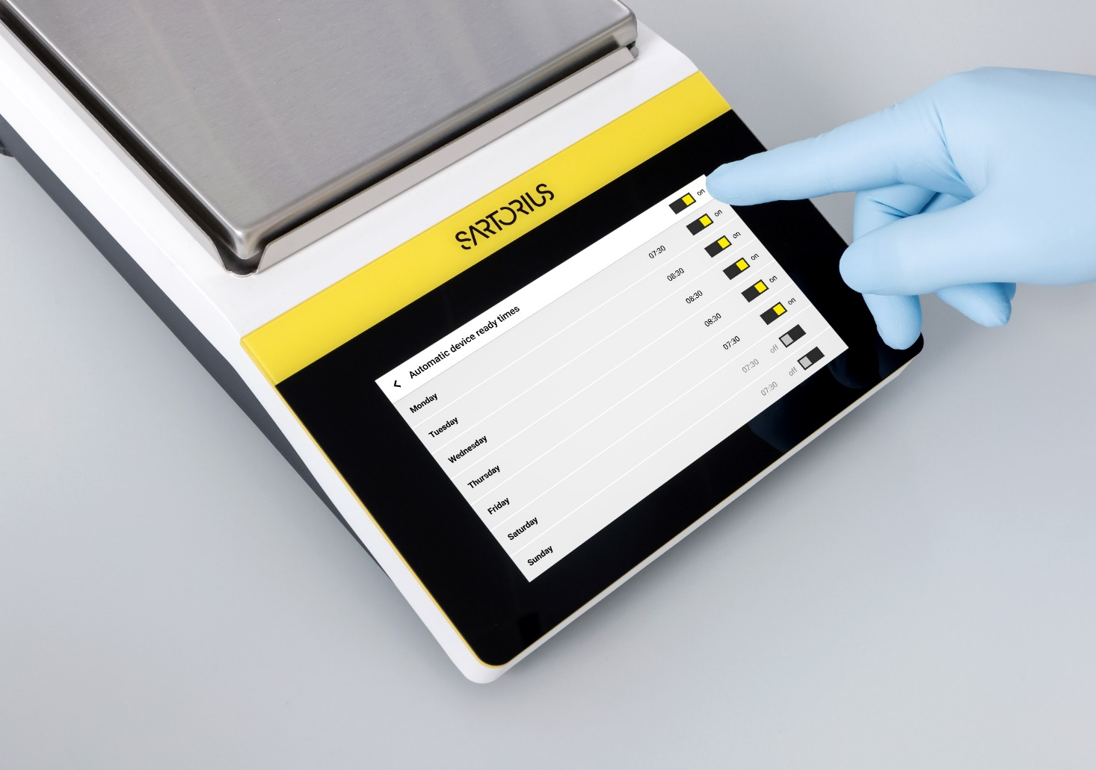
Key Selling Points
Sustainability
  User-defined, Automatic Start Timer powers up the instrument in-time for daily use (considering time for isoCAL, automatic levelling, acclimatization and warm-up)
Notes:
Setup a start time individual for each day in a week (7 days) when the Quintix® Pro shall be ready for use. The balance will consider the time for isoCAL, automatic levelling, acclimatization and warm-up to be ready for use at the pre-defined time.

Slide 20
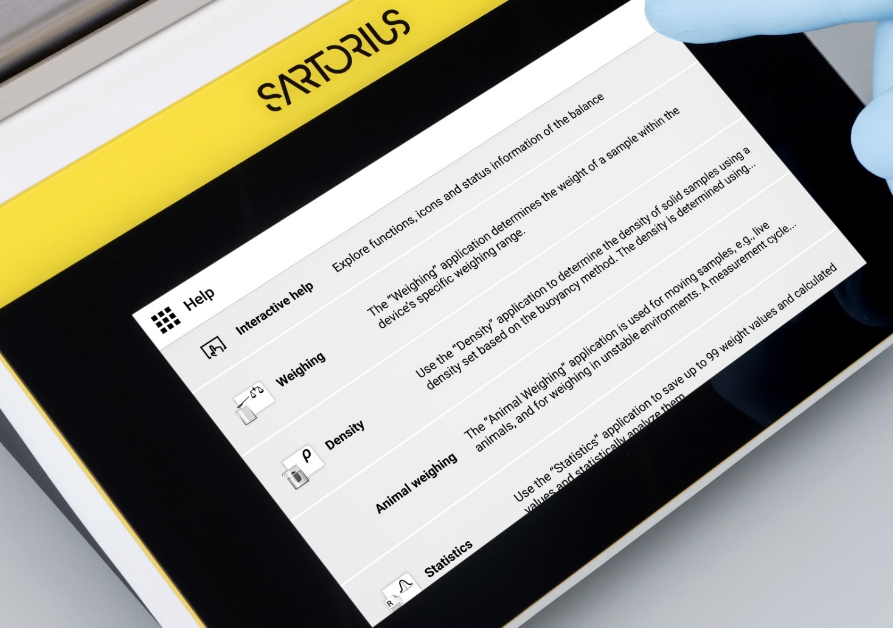
Key Selling Points
Sustainability
  Digital User Manual minimizes paper consumption, while allowing quick access to information and instructions
Notes:
Quick access to the integrated digital manual for common help topics. The digital user manual minimizes paper consumption, by that reduces the gross weight and reduces the transportation efforts.

Slide 21

Key Selling Points
Sustainability
  Climate-conscience production process utilizes recycled materials and in addition environment-friendly packaging
Notes:
Sustainability fact sheets will follow soon. They will provide all details coming along with CO2 footprint of the Quintix® Pro.
“30” > approx. 30% (in relation to gross weight) this is the content of recycled material which is used for the new balances.
“10,000” > 10,000 Watt per year is the average electricity savings per year with an average use of the new balance of 8 hours a day, 5 days a week.

Slide 22
Portfolio
Notes:
Let’s talk about the portfolio of Quintix® Pro.

Slide 23


Portfolio Overview
Quintix® Pro
Quintix® Pro
Models
Extended Weighing Ranges
1
18
up to 320 g @ 0.1 mg
up to 1,500 g @ 1 mg
up to 6,200 g @ 10 mg
up to 12,200 g @ 100 mg
Notes:
Quintix® Pro > 1 product family
18 models will replace 37 models (16 models of Secura® range and 19 models of Quintix® range)
by offering extended and higher weighing ranges at the same time
Important!!! Secura® and Quintix® semi-micro (5-decimal) and micro (6-decimal) balances will stay in our portfolio for now.

Slide 24
Material Numbers | Order Codes
Quintix® Pro
QTX | 224 | I | M | U | -1 | S
Product portfolio QTX = Quintix® Pro | Weighing range and readability Max. Capacity = 220 g Readability = 0.0001 g | Internal adjustment feature | Leveling R = Real-time level support M = Motorized level feet | Draft shield U = Manual analytical draft shield O = No draft shield | Product version | Country-specific term For details see next slide

Slide 25
Material Numbers | Order Codes
Quintix® Pro
QTX | 224 | I | M | U | -1 | S
Terms for country-specific models
Term | Country | Remark
S | Standard | Standard balances without country-specific additions
SAR | Argentina | Standard balances with country-specific additions for Argentina
SJP | Japan | Standard balances with country-specific additions for Japan
SKR | South Korea | Standard balances with country-specific additions for South Korea
CEU | Europe | Conformity-assessed balances with EU type examination certificate without country-specific additions
CFR | France | Conformity-assessed balances with EU type examination certificate only for France
NUS | Canada | USA | Balances with approval for Canada and USA
OBR | Brazil | Balances with approval for Brazil
OCN | China | Balances with approval for China
OIN | India | Balances with approval for India
OJP | Japan | Balances with approval for Japan
ORU | Russia | Balances with approval for Russia
Notes:
Possible country-specific terms for Quintix® Pro balances.

Slide 26
Sales Tools

Slide 27






Brochure, Data sheet, Manual
(German, English, French, Italian, Spanish, Portuguese, Chinese, Japanese, Korean, Russian)
Flash card & Competitor cross guide
(English)
Product pictures & Application pictures
Application videos & Product teaser video
Demo units & Transportation case
(for an analytical balance, a milligram balance or a precision balance incl. a printer)
Website
Notes:
Which sales tools will you get for the new Quintix® Pro product family?

Slide 28
Accessories

Slide 29
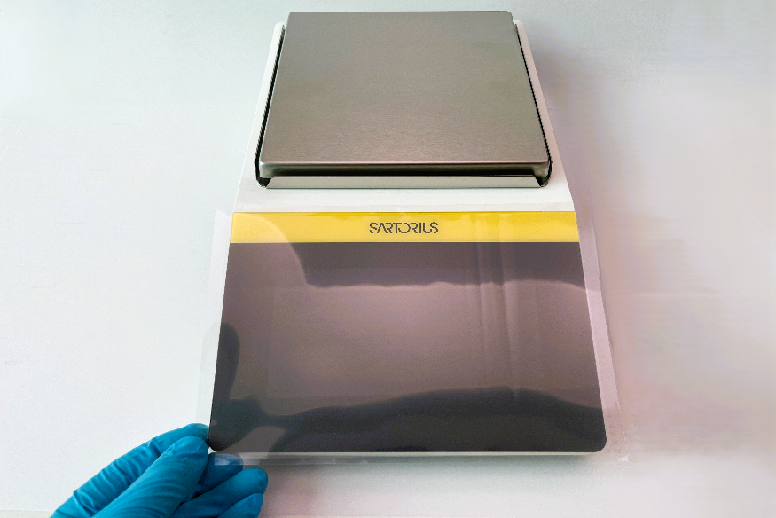
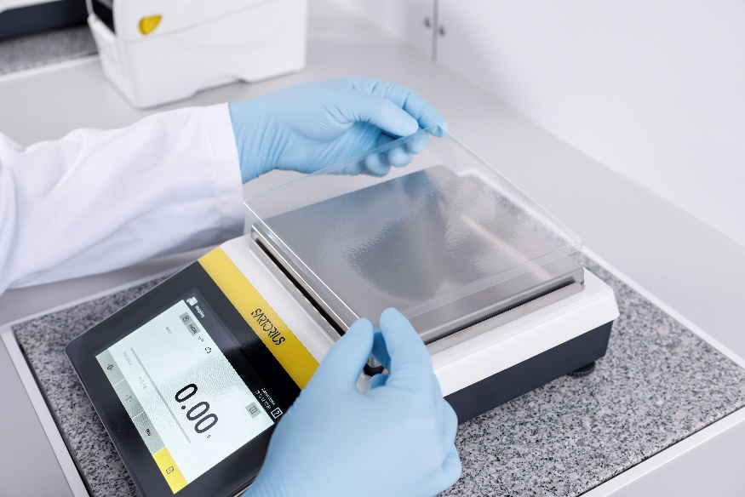
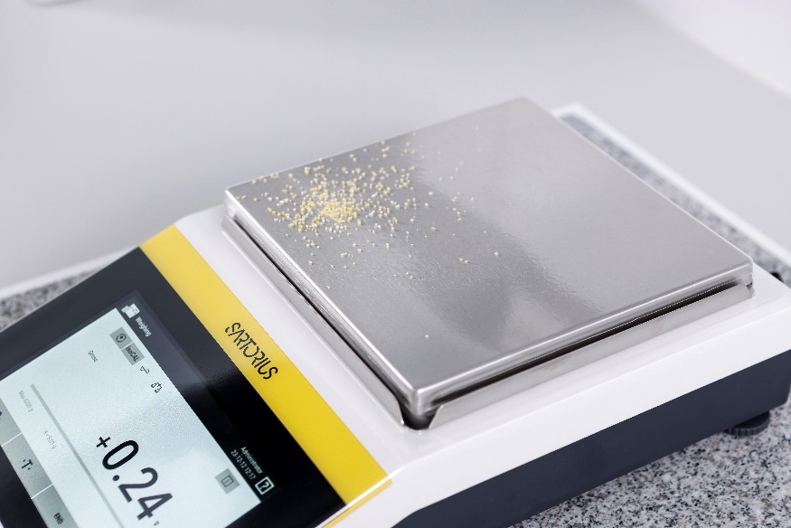
Optional Accessories
Quintix® Pro
Display protection film (set of 5)
YDC40
Set protection cover for weighing pan (set of 5)
YIC02-x
x = A for analytical balances
x = M for milligram balances
x = P for precision balances
In-use cover for balances
6960SExx
x = 08 for balances with an analytical draft shield (1 piece)
x = 08-5 for balances with an analytical draft shield (set of 5)
x = 09 for balances with rectangular weighing pan (1 piece)
x = 09-5 for balances with rectangular weighing pan (set of 5)

Slide 30
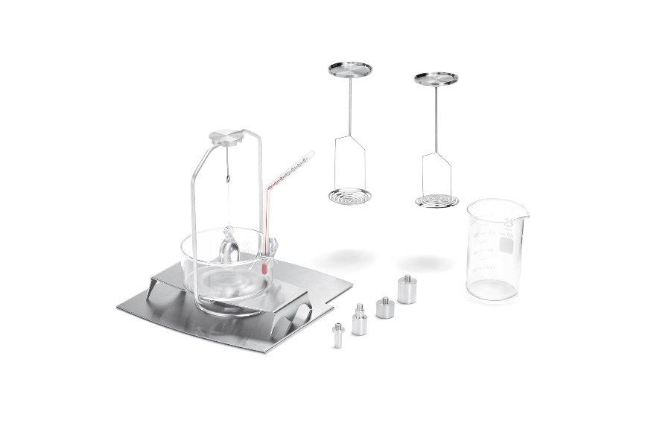
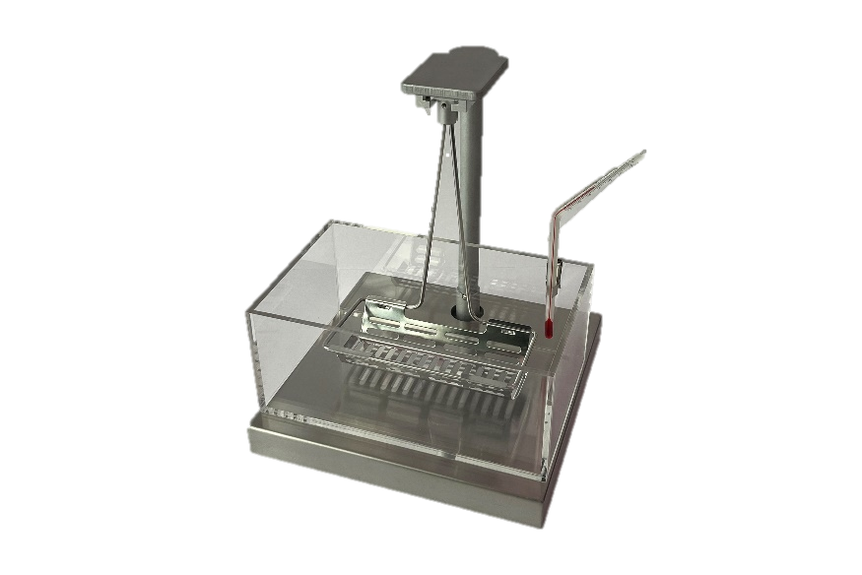
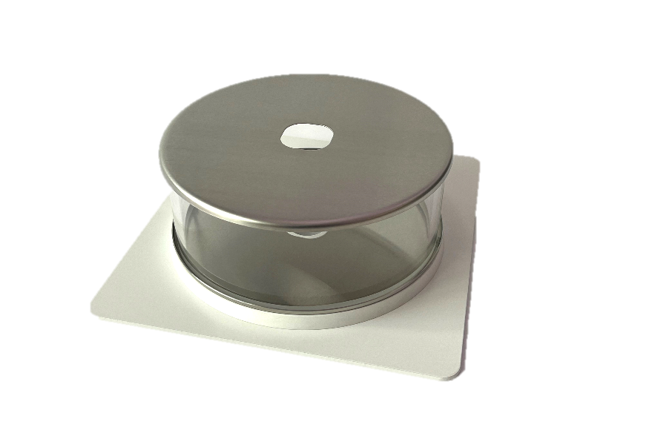
Optional Accessories
Quintix® Pro
Density determination set for solids and liquids for balances with a readability of 0.1 mg | 1 mg
YDK03
Density determination set for solids and liquids for balances with a readability of ≥10 mg
YDK04QTX
Round glass draft shield for balances with a readability of 1 mg
YDS02QTX

Slide 31
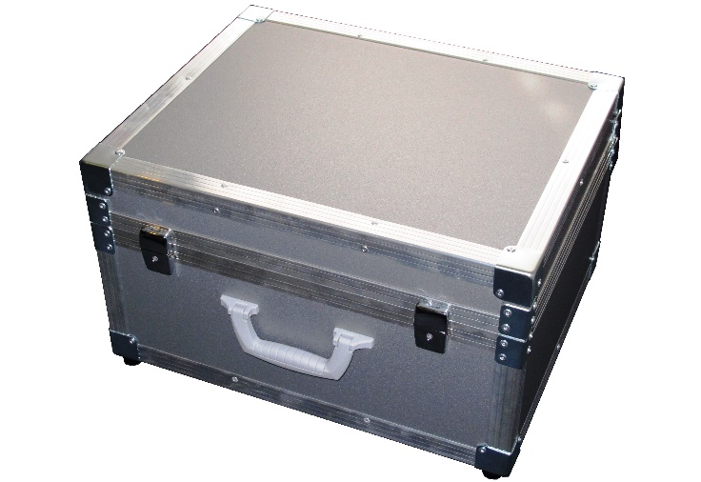
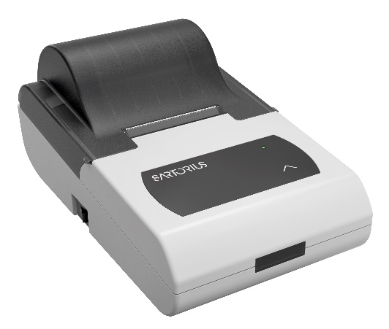
Optional Accessories
Quintix® Pro
Thermal transfer printer (USB-B, RS232)
YDP30
Dot matrix printer (USB-B, RS232)
YDP50
Demo | transportation case
YDB01QTX

Slide 32
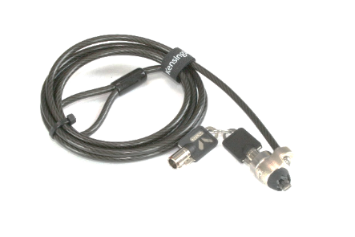
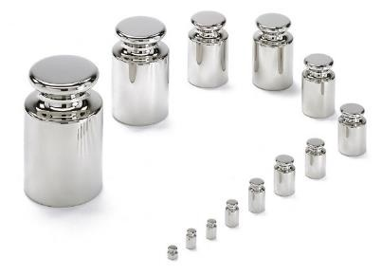
Optional Accessories
Quintix® Pro
YCC-USB-C-A,
Data cable
YCC-USB-C-B,
Data cable
YCC-D09M-USB-A,
Data cable
69Y03130,
Data cable
...and many more RS232 data cables
YCC-D09MM
YCC-D09MF
YCC-D09M-2D09F
YKL01,
Kensington-lock cable
YCC-5V-15V,
Converter Cable 5 > 15 VDC
Calibration weights

Slide 33
Quintix® Pro
Redefining the Standard
Notes:
Let’s redefine the standard in lab weighing.

Slide 34
Thank you.
Christian Weidner
Manager of PM Universal Weighing Solutions
Marketing
Phone +49551.308.3720
Mobile +49176.104.38912
christian.weidner@sartorius.com

