Slide 1

Umetrics® Ecosystem
SIMCA®-online News
2025-05-21

Slide 2
SIMCA®-online 18.1

Slide 3
SIMCA®-online 18.1
SIMCA®-online News
Extend data analytics in Umetrics® Studio
  Explore data outside SIMCA-online for new insights
Batch Identification
  Batch ID and metadata displayed in Unit Overview
  Reference batches in project configuration
Configuration Verification and Troubleshooting
  Export project configuration to pdf report
  Troubleshoot and validate configuration settings
Writeback Extension
  X-variables and Y-variables available for writeback, including generated and preprocessing variables
Web Client Updates
  Workset batches
  Additional reference batches
  Confidence limits displayed
  Coloring in charts by vector or batch
  Plot resizing
User Experience Improvements
  Quickly open desktop with ‘Open session workspace’ checkbox option in login dialog
  Updated built-in Web Client help, expanding all sections with Ctrl+F for easier search of help sections
Notes:
Add a ‘Why are we doing this?’ to every feature.

Slide 4
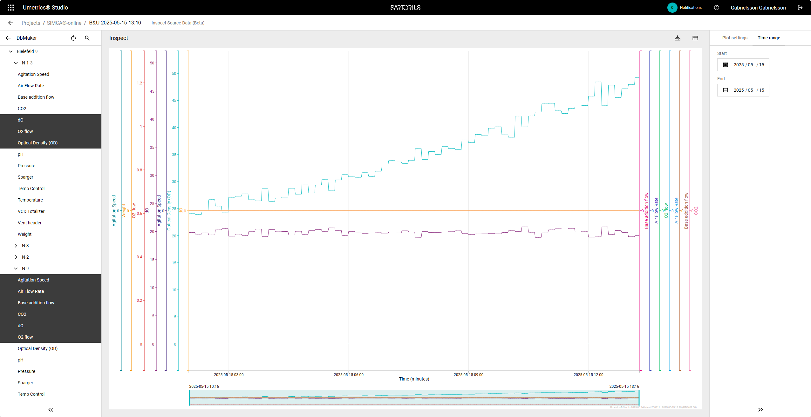
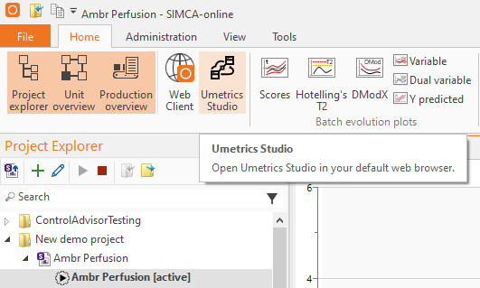
On Demand Process Data Visualization
SIMCA®-online News
Benefits
Visualize and analyze data linked to SIMCA®-online project
Rapidly add and explore data not included in model
Applies to
Server | desktop client
Changes
Data exploration tool opened from SIMCA®-online
Included variables in configuration preset in data exploration tool
Notes:
Add a ‘Why are we doing this?’ to every feature.

Slide 5
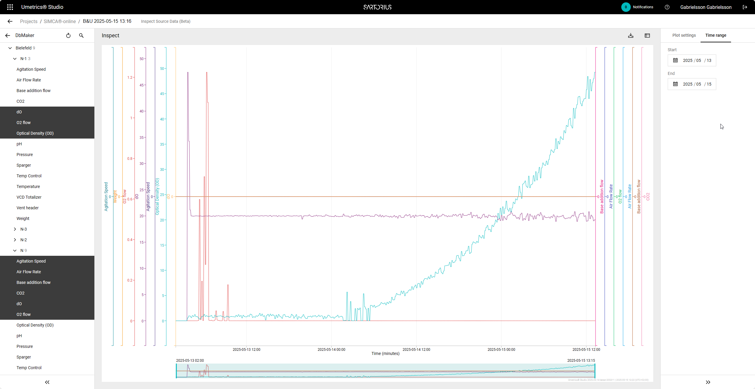
On Demand Process Data Visualization
SIMCA®-online News
View trends of variables in model and outside models
Simple navigation
Notes:
Add a ‘Why are we doing this?’ to every feature.

Slide 6
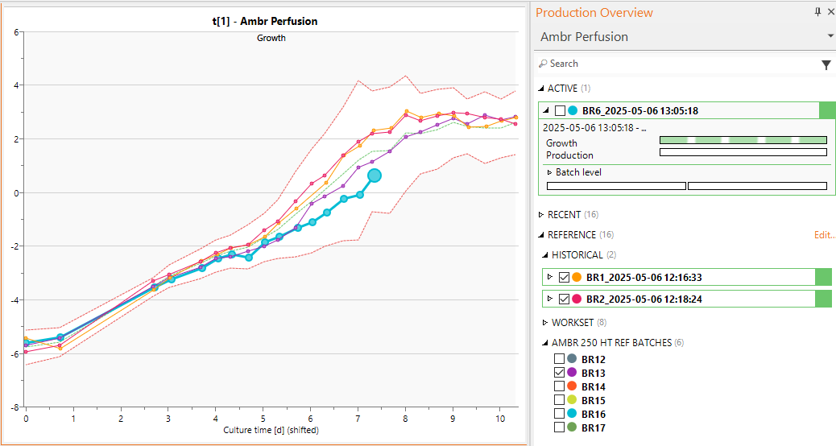
Reference Batch Visualization
SIMCA®-online News
Benefits
Compare current and recent to additional batches in clients
Display name of new reference batches customer specified*
Configuration settings enable same reference batches for all users
Applies to
Server | desktop client | web client
Changes
SIMCA® project predictionset batches exposed in configuration for optional selection
Workset and predictionset batches added to WebAPI
Single location “REFERENCE Edit…” for batches to compare to active or recent
*Name of predictionset defined in SIMCA®

Slide 7
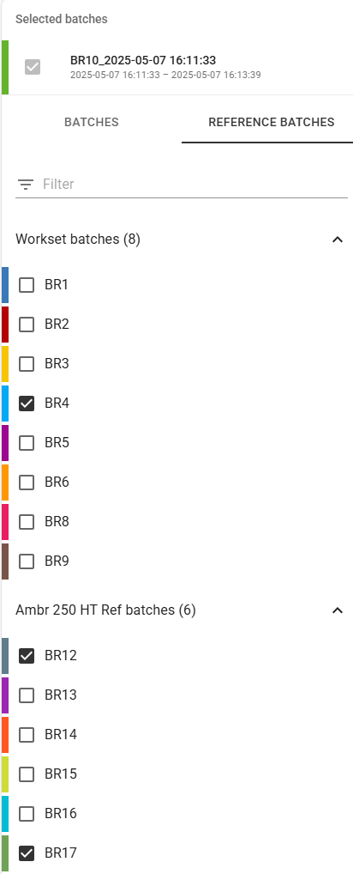
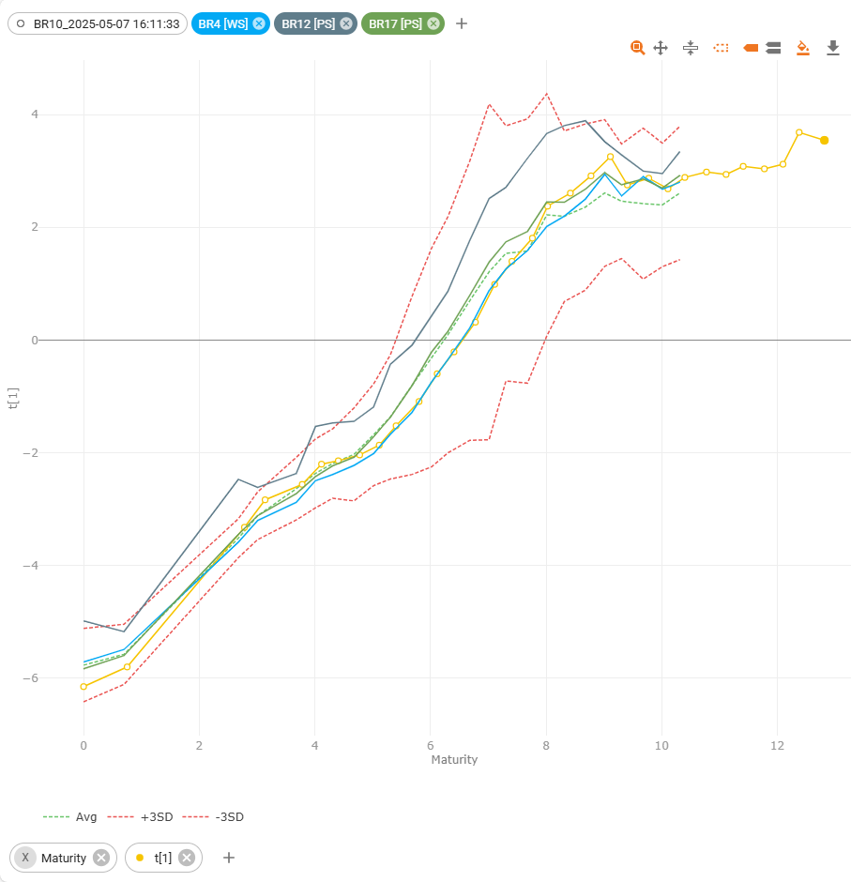
Reference Batch Visualization in Web Client
SIMCA®-online News
Benefits
Workset batches available to all users
Predictionset batches available to all users
Configuration specified reference batches can be added in charts
Applies to
Web client
Changes
Expose Workset and Predictionset batches of configuration in WebAPI
Notes:
Add a ‘Why are we doing this?’ to every feature.

Slide 8
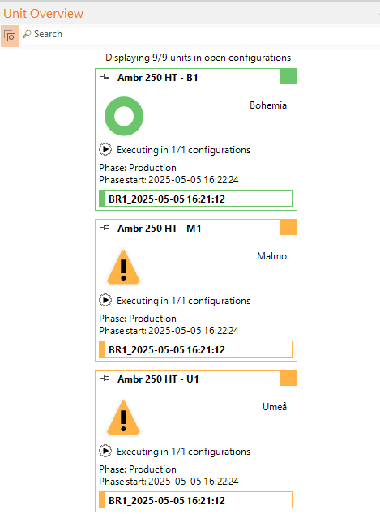
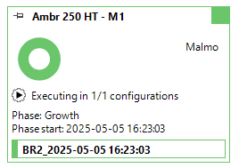
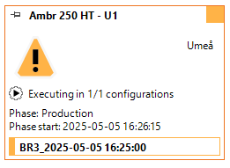
Identification of Running Batches in Unit Overview
SIMCA®-online News
Benefits
Identify batches running in units
Batch ID and metadata can be used as search criteria in Unit Overview
Applies to
Server | desktop client
Changes
Added Batch ID
Added Phase start
Added Configuration metadata
Notes:
Add a ‘Why are we doing this?’ to every feature.

Slide 9
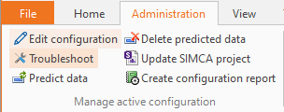
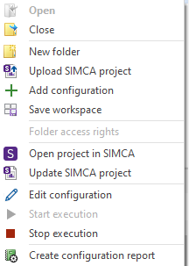
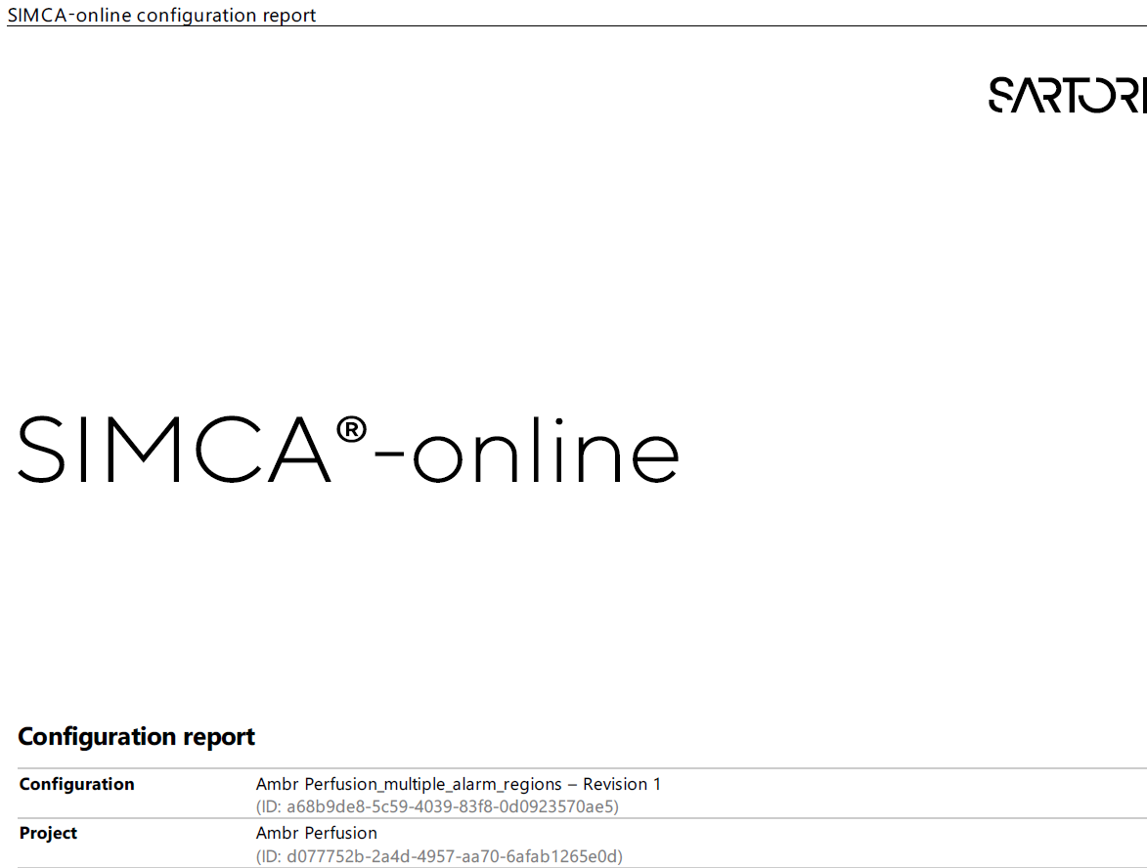
Configuration Verification
SIMCA®-online News
Benefits
System generated report of project configuration for compliance reporting
Document system setup with support for future verification
Applies to
Server | desktop client
Changes
Customizable XSLT template added to server
Create report (and select template) in Administration tab or configuration context menu
Permission required: ‘Manage Configurations’ or ‘Create Reports’

Slide 10
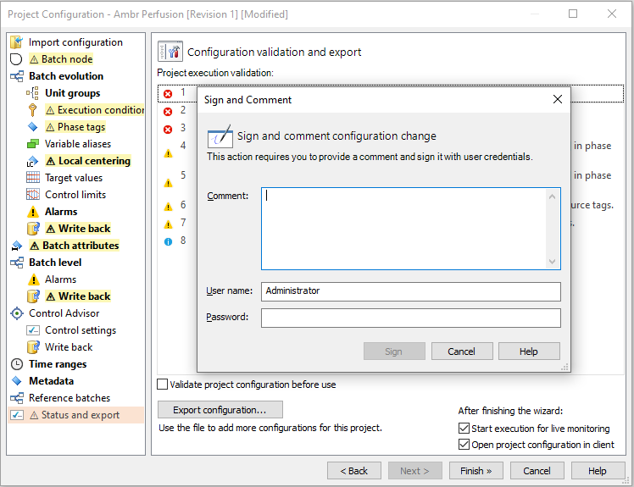
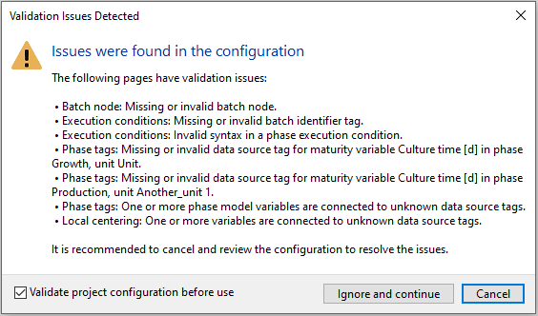
Configuration Validation and Trouble Shooting
SIMCA®-online News
Benefits
List all potential issues of project configuration
Pages with issues highlighted with icon and color in tree
Updated pages highlighted in bold in tree
Validation streamlined and can be suspended
Applies to
Server | desktop client
Changes
Execution settings validation results highlighted in configuration wizard
Summary page of potential issues
Checkbox to temporarily not perform validation
Notes:
The validations is done when
-you turn on execution,
-predict a batch
-or troubleshoot a project configuration
and shows a message if there are issues.
There is now a checkbox that you can use turn off validation for the project configuration if you find that it lists a potential issue that you know can be ignored. There is also a button for directly opening the configuration to correct any issues:
if you just want to log in as quickly as possible without re-opening the project configurations and plots that were open the last time you logged out.
the workspace you had before unchecking the checkbox will be loaded upon login.
This checkbox moves the setting in File > Options > Session workspace outside of the session login.

Slide 11
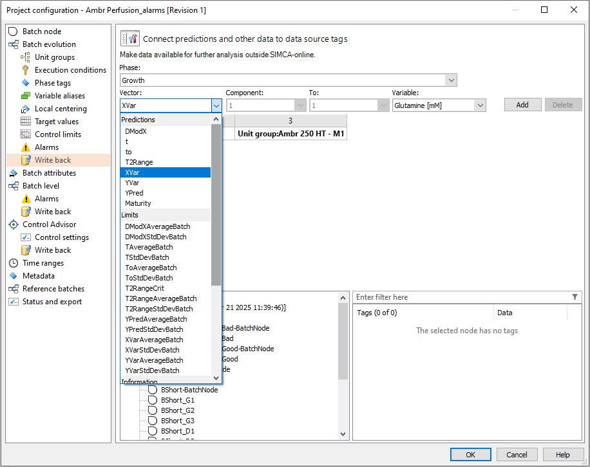
Write Back Improvements
SIMCA®-online News
Benefits
Write back all data that is created in SIMCA-online
Applies to
Server | desktop client
Changes
XVar and YVar added to vectors available for write back
Includes generated and Python preprocessed variables

Slide 12
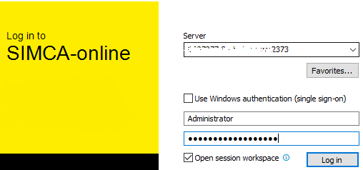
User Experience Improvement
SIMCA®-online News
Open session workspace
If unchecked, save time by not opening project configurations and plots
Check again to open project configurations and plots that were open at last logout

Slide 13


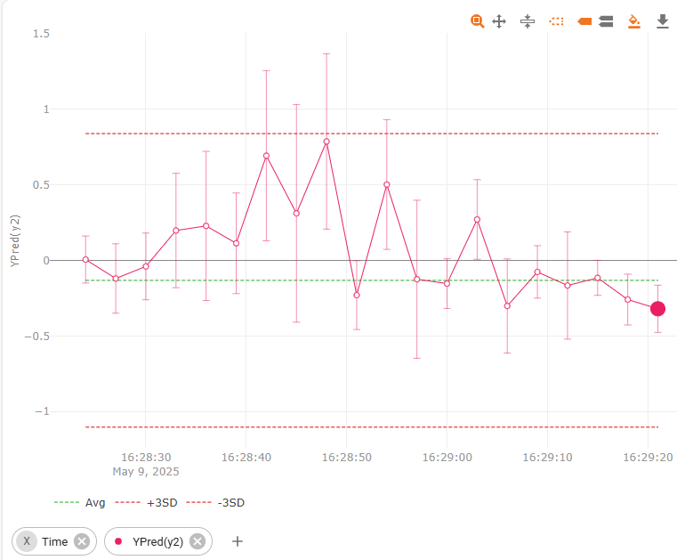
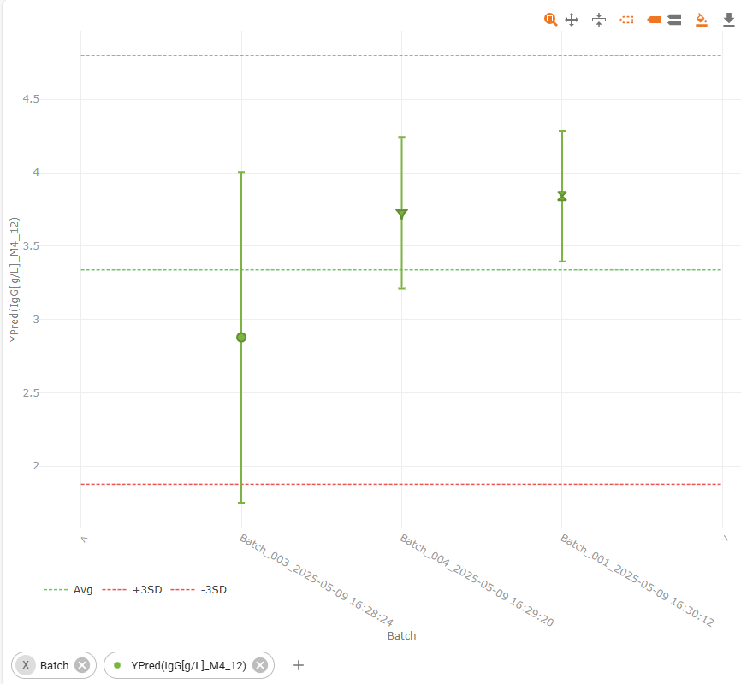

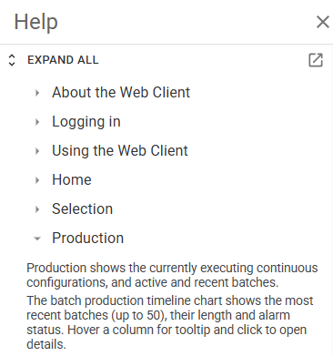
User Experience Improvements in Web Client
SIMCA®-online News
Plot Updates
Confidence limits for more model types, extending desktop client for continuous (toggle on | off in settings)
Color by batch or series in charts
Added chart axis labels
Maximize plot option
Updated built-in help in Web Client
Easier to search help sections by expanding all sections on Ctrl+F/Cmd+F
Expand all/collapse all sections button
Open help sidebar on login page when pressing the Help button

Slide 14
Smaller Updates
SIMCA®-online News
Compatibility with SIMCA® 18.1
Support for updating alarms in SIMCA with roundtrip possible
Python 3.13 for numerical preprocessing scripts with pandas 2.2.3, numpy 2.1.3, scipy 1.14.1 built in as SIMCA® 18.1. Packages can be updated and added as required
Desktop Client
Configuration Audit Trail, alarm traceability improved by adding reset_alarm comment to alarm_triggered event
Configuration of projects with Control Advisor functionality, automatically suggested manipulated variables (Xmv), introduced in SIMCA®-online 18, can now be re-triggered for ease of use
For clarity, View | Report only shows phase iteration number for evolution level alarms
Web Client
Separate the about and help page to two separate pages: About, and Help
Date-time picker for continuous chart end time, making it simpler and faster to input an end time, especially on mobile
Notes:
Python has been upgraded to 3.13 with NumPy 2.1.3 and SciPy 1.14.1 Pandas 2.2.3.
Configuration of Control Advisor: filling in these by first unselecting all variables, and then re-opening the dialog for selecting them
For clarity, View | Report, phase iterations don’t apply to Batch Level Models and should not be displayed as it can be confusing.

Slide 15
Smaller Updates
SIMCA®-online News
Server | System
Fixed: Memory leak in Round and ISNAN generated variable functions
Fixed: Preprocessing on the batch level data in combination with phase iterations results in no batch level predictions
Fixed: Server does not catch up when falling behind for Control Advisor projects
Fixed: Configuration running discrete data and out limits results in server crash and incorrect data
Fixed: T2Range contribution performance, plots for projects with many workset batches could be very slow to open
Fixed: -99 could be interpreted as missing
Desktop Client
Fixed: Control limits outside standard not saved in project configuration
Fixed: Control limits outside standard colored asymmetrically
Fixed: Zoom in active phase not working if phase changed when user not logged on
Web Client
Fixed: Configured limits for target values now show up in charts even if alarms have not been specified
Fixed: Switching between different variables too quickly can make web client unresponsive
Fixed: Numerical batch IDs would be formatted using scientific notation instead of text
Fixed: Missing multiple y-axis button in plot toolbar
Fixed: Missing excluded variables that are part of a generated variable
Notes:
Control Advisor Performance improvement:
When the project configuration execution is falling behind the Control Advisor predictions will be temporarily disabled until the project configuration is back on track
Missing value: Reading -99 from a data source is transformed into a value very close to -99 since it would otherwise be interpreted as missing.
Issue: reported by
Memory leak: Samsung
Preprocessing and phase iterations: Eli Lilly (for work done on their behalf)
All three Desktop client bugs: Eli Lilly
All web client bugs: Regeneron

Slide 16
SIMCA®-online 18

Slide 17
SIMCA®-online 18
SIMCA®-online 18 News
News
Adaptive Process Mode
  Combine batch and continuous models in a single project
Alerting extensions
  Alarm regions and multiple alarms per data vector for batch evolution
  Trigger-based alarms for all variables
Visualization enhancements
  Scale phases evolution chart by duration
  Updated default settings for contribution
Performance improvements
  Improved server responsiveness and memory usage
Server security improvements
News Continued
  Web Client
    Multiple alarm regions
    Add note
    Time-consuming data load awareness
Other updates
  Notification improvements and new events
  Control Advisor improvements for batch projects
  Batch ID in writeback for Alarm URL
  User experience improvements and Web-based Help format
SIMCA® 18 Compatibility
  Use projects with reordered phases
  Use variables generated from qualitative
  Calibration transfer
  Update of bundled Python versions

Slide 18
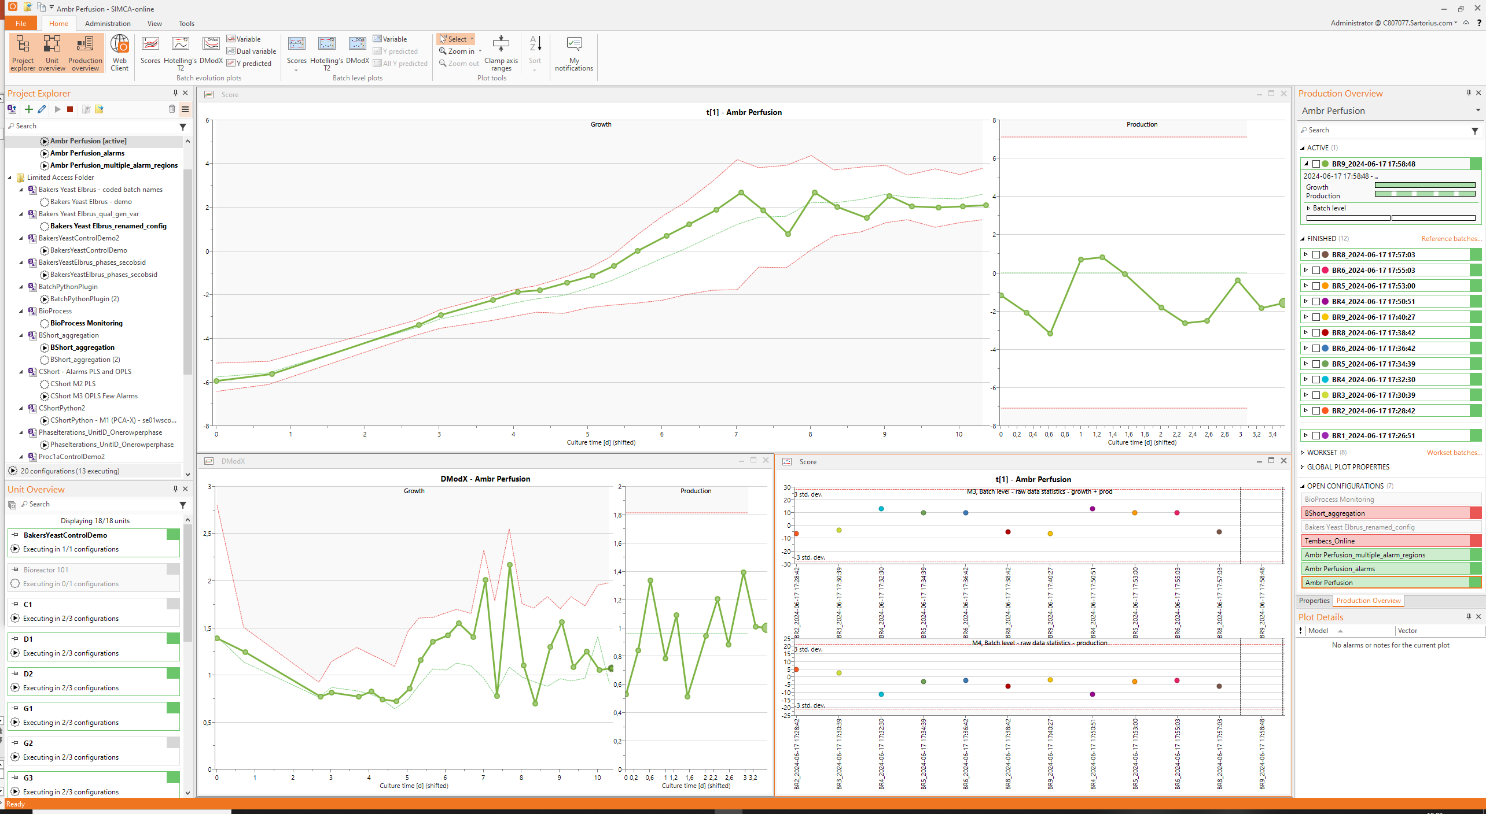
Combine Batch and Continuous Models in a Single Project
Adaptive Process Mode
Benefits
  Enhanced process control with Adaptive Process Mode
  Gain comprehensive process understanding by covering dynamic and steady-state phases
  Combine dynamic and steady state phases in single
  project or configuration
  Predictions of Critical Quality Attributes possible for all phases
Applies to
  Server | desktop client | web client
Changes
  Support for PCA in batch projects
Notes:
Commercial manufacturing
Dynamic initial phase: growth phase until equilibrium established
Steady-state phase: continuous growth and harvest
Additional dynamic phase(s): Cool down, etc

Slide 19
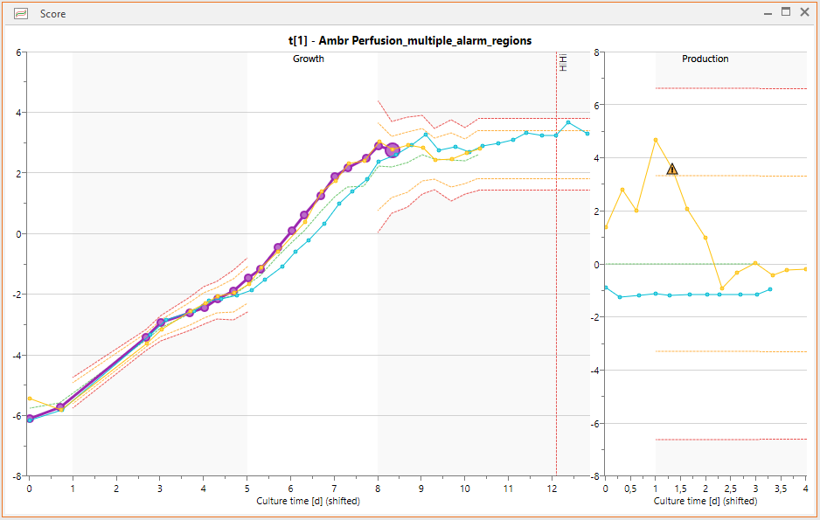
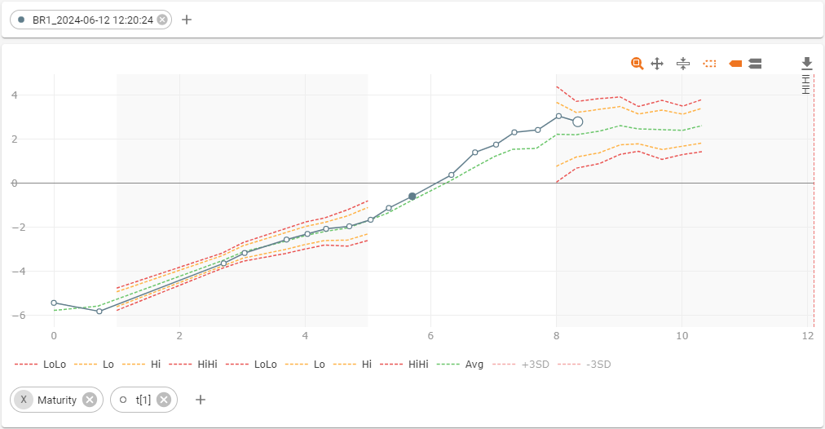
Alarm Regions and Multiple Alarms
Per Data Vector for Batch Evolution
Alerting Extensions
Benefits
  Enable highly specific alarms with regions for batch evolution
  Allows for tighter alarms for critical parts of the process
  Allows for different rules for Warning and Critical alarms
  Avoid spurious alarms for parts of process known to be noisy
Applies to
  Server | desktop client | web client
Changes
  Added multiple alarm groups that each have triggers, region and vectors
  Option to add Start and/or Stop Maturity for Alarms triggers that defines region where alarms are evaluated
  Outside the region an alarm is not evaluated and cannot be triggered

Slide 20
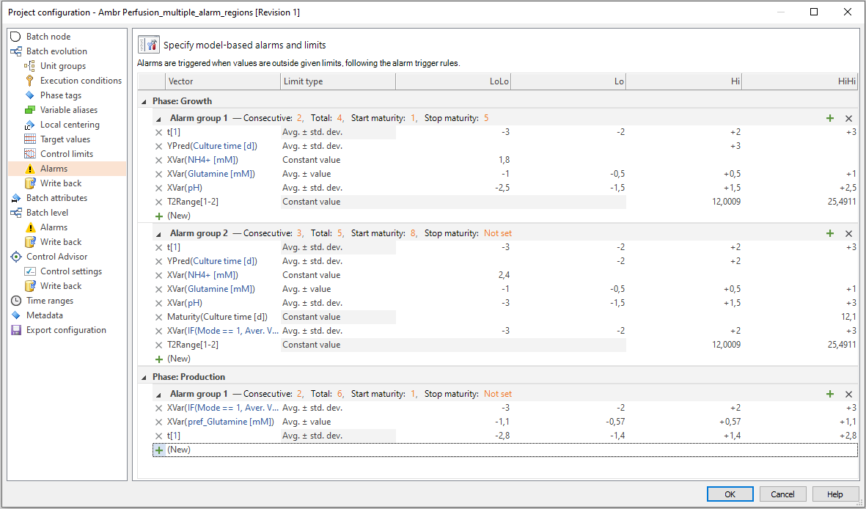
Trigger Based Alarms
For All Variables
Alerting Extensions
Benefits
  Flexible alarm configuration for all variables in batch evolution
  Set alarm when process starts early | runs for too long
Applies to
  Server | desktop client | web client
Changes
  Added support for XVar, including generated and preprocessing variables
  Added support for YVar | Ypred | Maturity
  New limit type: Average ± value

Slide 21
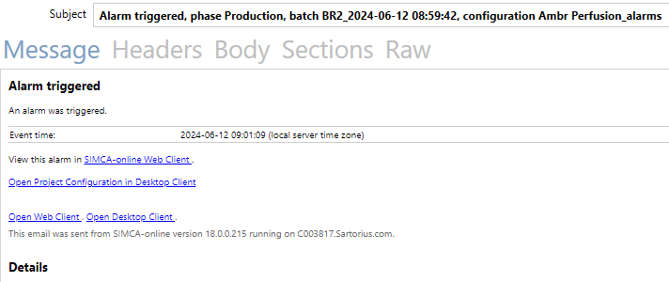
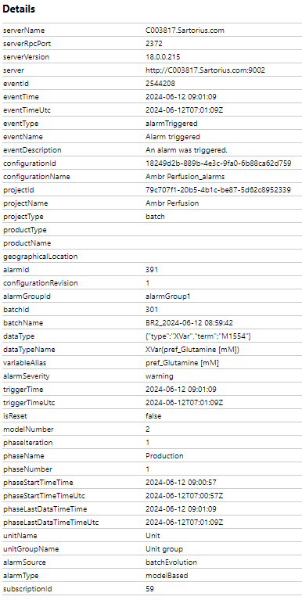
Improved Notifications
Alerting Extensions
Benefits
  Easier to provide relevant information to stakeholders
  Admins can be notified of system performance
  Users can be informed of specific events
Applies to
  Server
Changes
  Template for editing subject of notification
    Short human readable intro in notification emails and application event log entries
  serverExecutionFallingBehind is a new event, can be used by admins to get notifications when the server is too busy
  phaseStarted and phaseFinished events added
  alarmTriggered extended for easy differentiation between target value and multivariate alarms, also includes phase information

Slide 22
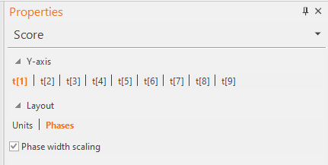
Scale Phases by Duration
Visualization Improvements
Benefits
  Intuitive indication of phase length makes is easier to interpret
  Easier to identify single observations for further analysis
Applies to
  Desktop client
Changes
  Added option to use Phase width scaling in evolution plots

Slide 23
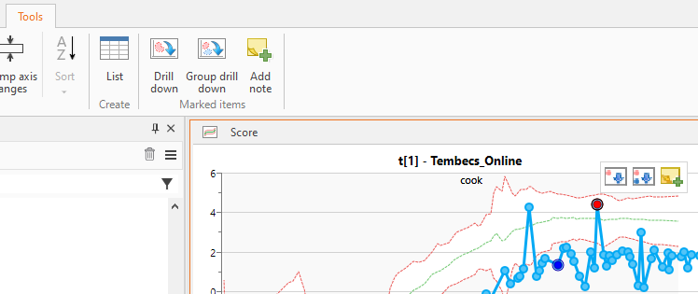
Improved Drill Down
New Default and Added Group Comparison Button
Visualization Improvements
Benefits
  Consistent behavior on double click makes it easier to create intended drill down plot
Applies to
  Desktop client
Changes
  Double click on observation always opens point to average contribution
  Added button for group-to-group drill down

Slide 24

Improved Server Responsiveness and Memory Usage
Performance Improvements
Benefits
  Faster server startup and shutdown
  Improved performance for all data sources
  Sustainable memory consumption
Applies to
  Server
Changes
  Server startup loads SIMCA projects in parallel
  Server shutdown stops configurations in parallel
  Server flag for turning off grouped reading from data source
  Server can be configured for concurrent SimApi access to data sources
  Server logging improvements

Slide 25
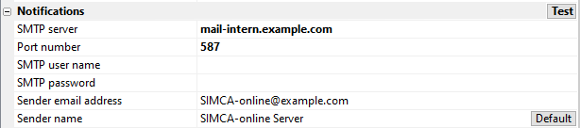
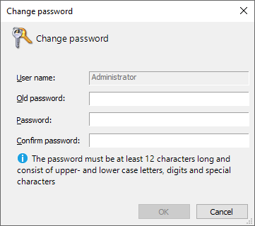
Improved Server Security
Security Hardening
Benefits
  Encrypted and authenticated SMTP for email notifications for wider
  support of email servers
  Prevent brute force attacks and high-jacking user session
  Password requirements increases minimum security
Applies to
  Server
Changes
  Enable use of STARTTLS, TLS/SSL in general, for communication between SIMCA-online server and email server
  SMTP user and password added for authentication – Test button to verify changes without server restart
  Stronger hash for password
  Added back-off algorithm to prevent brute force attacks
  Web Server cookie entropy has been increased to 256 bit
  Password Policy for users outside Active Directory

Slide 26
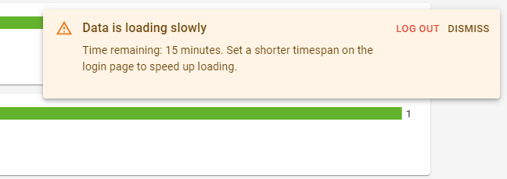

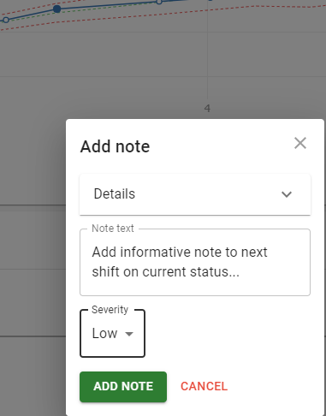
Updates in Web Client
Web Client Updates
Benefits
  Advanced alarms visualization available for all users
  Add note to improve traceability and communication across user groups
  and clients
  Avoid unnecessary waiting and server impact by cancelling Web Client
  loading of data
Applies to
  Web client
Changes
  Alarm regions are visualized in charts highlighted with other background
  and hidden limit lines outside regions
  Add note enabled
  Added warning when data is slow to load
  Tech stack updates
    Third-party libraries with the latest updates
    Future proofing use of modern development tooling and infrastructure

Slide 27
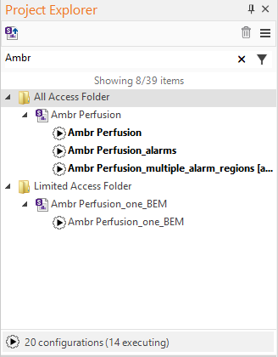
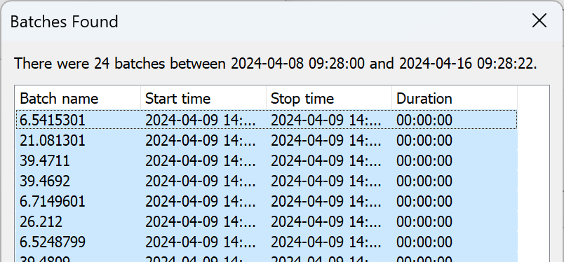
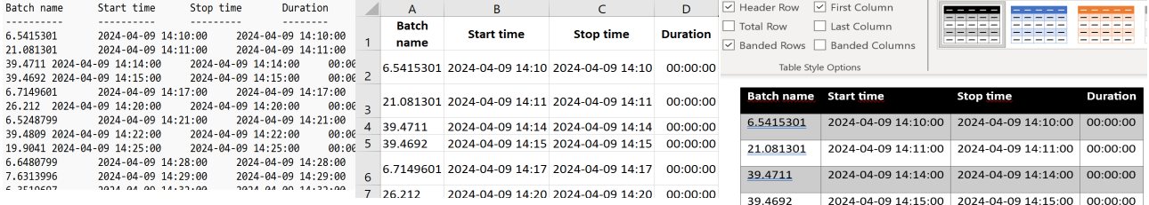
Project Explorer, Plots, and Lists
Improved Desktop User Experience
Other Updates
Benefits
  Improved Project Explorer with filter information and summary of
  configurations on server
  Easily copy information to other software and editors
  Improved visibility of Zoom subplot icon
Applies to
  Desktop client
Changes
  Project Explorer
    Shows total number of configurations and number of executing
    configurations
    Filter result information displayed
  Improved Copy to Clipboard added to the Batches Found dialog,
  Audit trail, Report etc, including column headers
  Zoom sub plot mini toolbar could initially appear in wrong
  position|outside the plot

Slide 28
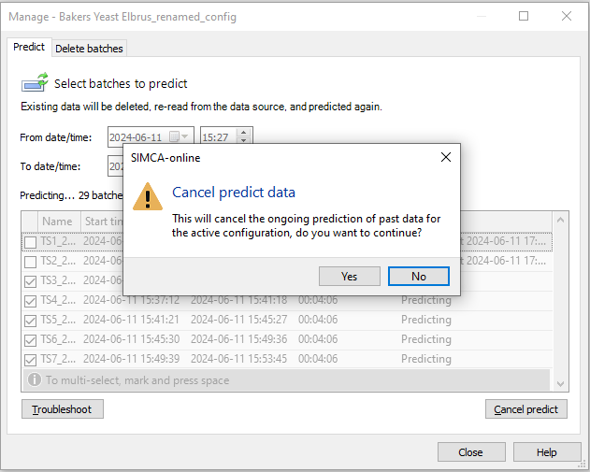
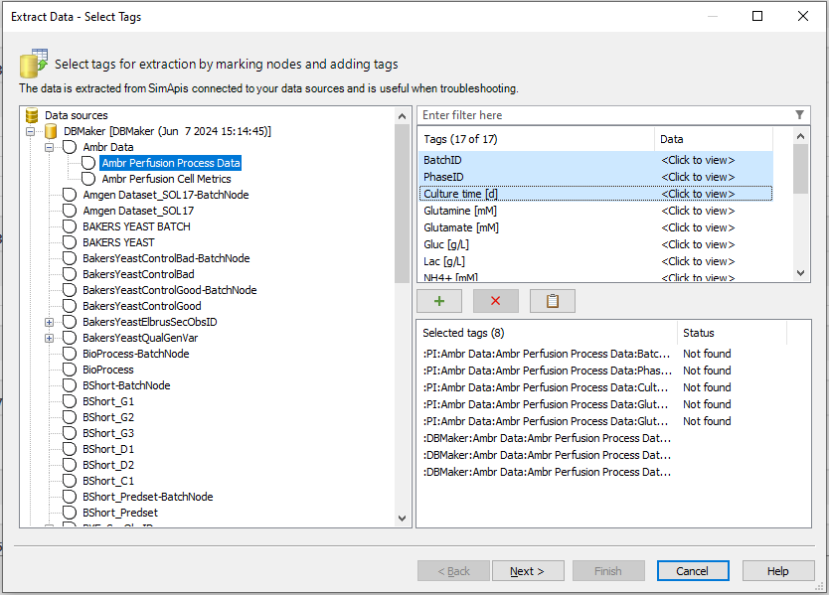
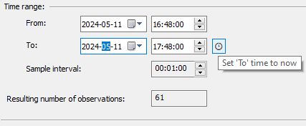

Predict and Extract, New Help File Format
Improved Desktop User Experience
Other Updates
Benefits
  Possibility to avoid server load and time-consuming prediction
  operations
  Easier to use File > Extract including paste list of tags, status message
  and select time | batches dialogs
  Easier to use Select Time and Select Batches dialogs
  Improved Help search result presentation and high-resolution screen visibility
Applies to
  Desktop client
Changes
  Cancelling predict of historical data
  Cancelling is more direct for File | Extract and View | Data List
  Changed dialog and added paste functionality
  Select time informs instead of changing values when From | To are not aligned and has ‘Now’ button
  Web based Help file format

Slide 29
Improved SIMCA® 18 Compatibility and System Updates
Other Updates
Compatibility with SIMCA® 18
Server | System
Support for projects with reordered phases
Calibration transfer for continuous processes
Generated variables of qualitative variables
Python 3.10.2 for numerical preprecessing scripts with pandas, numpy, scipy built in as SIMCA 18. Packages can be updated and added
Write-back of numeric batch number for alarm URL, for use in external systems to create links that open the SIMCA-online Web Client to show a specific batch.
Control Advisor improvements for batch projects: support for phases with generated variables, Python preprocessing variables, qualitative variables, out-of-order and incomplete forecast models
The data source node/tag hierarchy can handle child nodes with the same names as tags, common in OPC UA

Slide 30
Bug Fixes with Details
Other Updates
Server | System
Fixed: Maturity generated with function IndexByPhase
  In previous versions of SIMCA-online phase iterations failed to start at 0 when maturity generated with function IndexByPhase was used. With the fix the visualization of phase iteration projects with this maturity will be correct.
Desktop Client
Fixed: Contributions wrong for Control Advisor series (KB article)
Fixed: Workset batches dialog opened from Production Overview should remember previously selected batches
Fixed: Cannot delete one's own notifications from the My Notifications Details page without holding the manage_notification permission
Other
Fixed: Outlimits not applied after SimApi restart

Slide 31
SIMCA®-online 17

Slide 32
SIMCA®-online 17
2022-03-01
News
Batch Aggregation nodes in Batch Context Generator
User defined Python libraries for preprocessing
Manage data source connections on the fly
Performance optimizations
Active directory improvements
Model update automation
Minor updates
  UX improvements in desktop client
  Baseline Filters to combine IPC and process data
  Suppress alarm notifications during predict of past batches
Bug fixes
  Server crash when alarm notification is sent at the same time as the configuration it belongs to is deleted (system)
  Deleting multiple projects and configurations when the tree is collapsed does not always count the number of items correctly (desktop client)
  Reset button on login page only works once (web client)

Slide 33
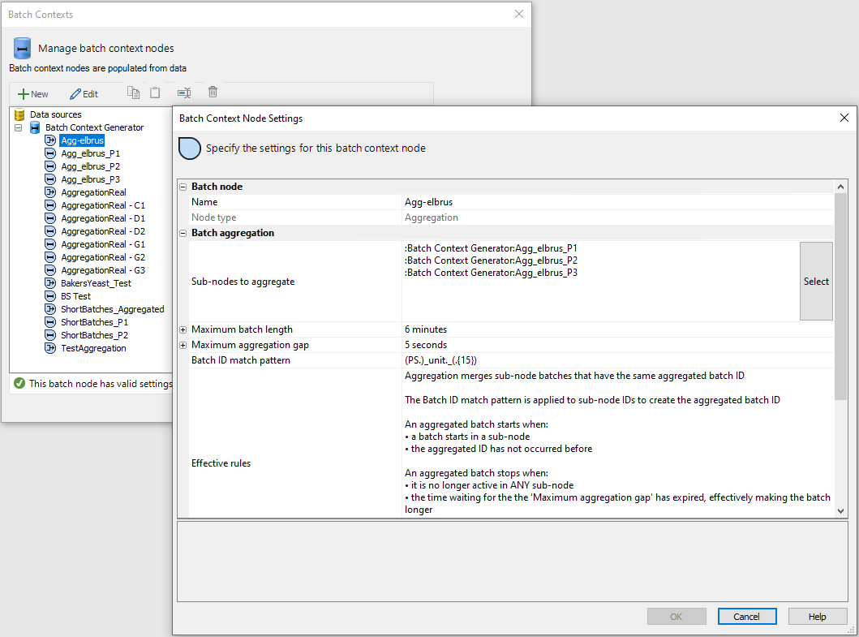
Batch Aggregation Nodes in Batch Context Generator
SIMCA®-online 17 News
Benefits
  Detect and correct deviations in multi-unit processes with improved access to process data
Apply to
  Server | desktop client | web client
Change
  Added aggregation nodes, which is a new type of node in Batch Context Generator
  Data can be combined and monitored at the batch level since all units are executed in the same project
  Batch ID match pattern in batch context node settings, batches with similar, but not identical, IDs can also be aggregated
  Improved Batch Context generator work-flow
Informative reason for resetting the alarm

Slide 34




User Defined Python Libraries for Preprocessing
SIMCA®-online 17 News
Benefits
  Customer free to use any analytics within Python realm
  Use flexible scripting to further enhance SIMCA®-online functionality
Apply to
  Server
Change
  Match python package versions with SIMCA® 17
    Python version 3.7.9
    NumPy (1.19.5), SciPy (1.6.0) and Pandas (1.2.0) bundled
  Script added for installing Python packages that are compatible with main version and have no graphical UI
  User free to add any python package

Slide 35
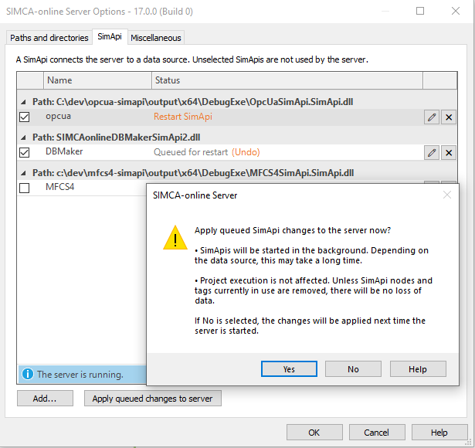
Manage Data Source Connections on the Fly
SIMCA®-online 17 News
Benefits
  Data source connections can be updated at any time without interrupting users or live monitoring of the process
  Down-time reduced to zero
Apply to
  Server
Change
  Administrators can manage SimApis on a running server, without affecting project execution
    add a new SimApi
    restart individual SimApis or include new data source tags
    disable or remove SimApis from the server
  Solution for backup with e.g. windows volume shadow copy service

Slide 36
Performance Optimizations
SIMCA®-online 17 News
Benefits
  For a single project configuration reads are reduced by 50 to 67%. When many projects execute at the same time, the number of reads are reduced even more
  Plot update time decreased
  Add data for project update (up to 4 times faster)
Applies to
  SIMCA®-online system
Change
  Grouping many data reads into single reads from a data source
  Can keep up with executions of more configurations
  Less traffic between SIMCA-online and the data source, and thus less load on the data source itself and the network
  The server is less sensitive to slow data sources and high latency in the network to the data source
  Updated plot library
  Improved method adding data on server for project update

Slide 37
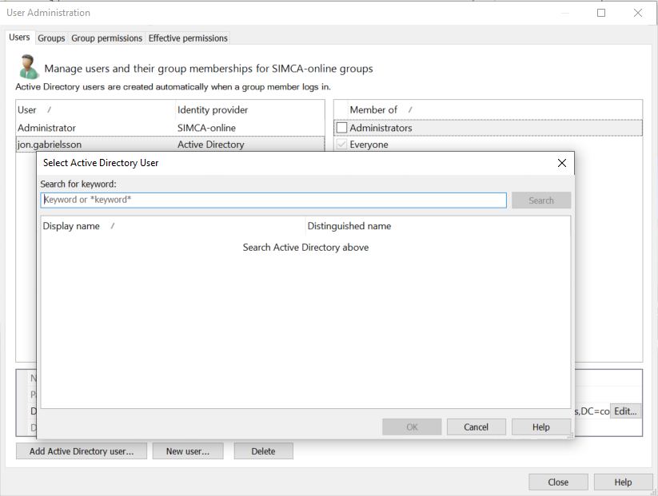
Active Directory Improvements
SIMCA®-online 17 News
Benefits
  Reduced need for manual user management, while keeping full control of which users are allowed to log in.
Applies to
  SIMCA®-online system
Changes
  Search for AD groups and users by name or email (wildcard and substring search supported).
  Names of users and groups from AD are used in
  SIMCA®-online which makes it easy to identify groups and users.
  Display name for Active Directory users is used to annotate user actions in alarms, notes and other places.
  Changed how Active Directory is set up and tested in
  SIMCA®-online Server Options. The entire domain can be searched for groups and users (also when migrating from an earlier version).

Slide 38
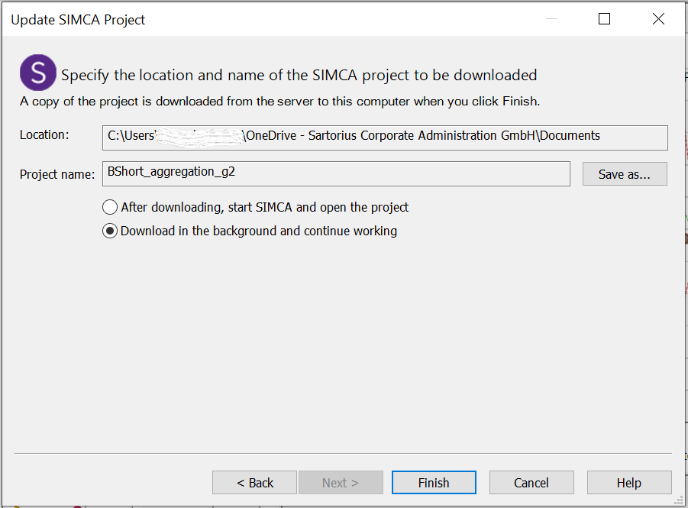
Model Update Automation
SIMCA®-online 17 News
Benefits
  Save time by automating the model update procedure
  Minimize likelihood of false positive | negative results in process deviations are identified
Applies to
  Desktop client and server
Changes
  Batch download of SIMCA® projects, download in the background
  Update project considerably faster compared to previous versions thanks to improved write speed when adding data
  Customer can script the model update for a fully automatic model update (only need to sign when uploading updated project to SIMCA®-online)
  Script example available upon request for triggering update of SIMCA® project

Slide 39
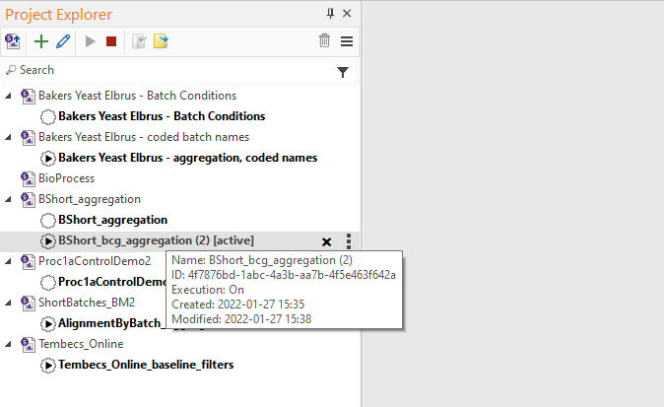
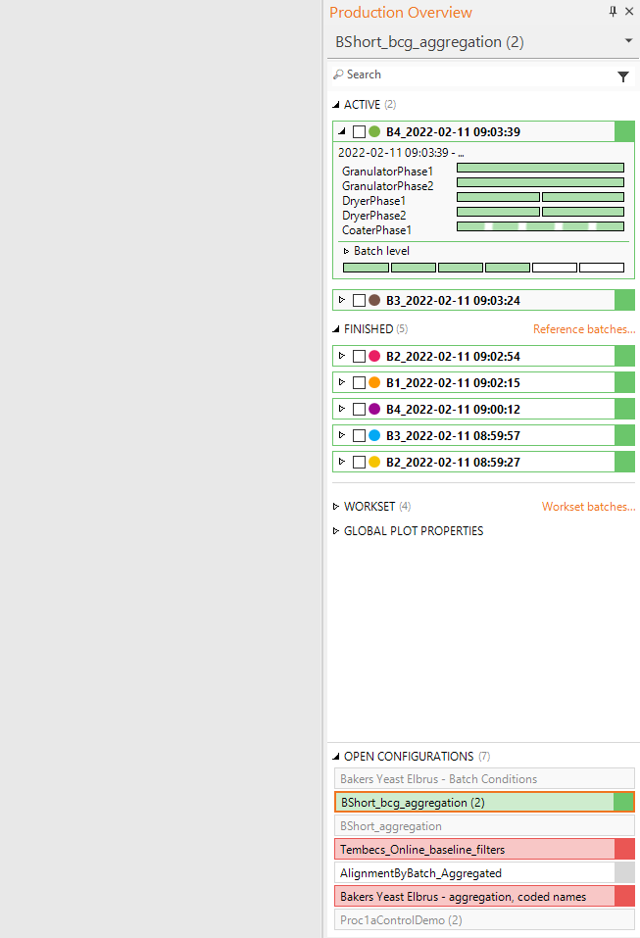
UX Improvements in Desktop Client
SIMCA®-online 17 News
Context dependent toolbar
Name of active configuration
Search for projects and
configurations by name/status
Search for batches
Benefits
  Improved Production Overview with overall alarm status and separate desktop contents
  Simplified Project explorer focused on admin management of projects
Apply to
  Desktop client
Change
  Production Overview
    Configuration status
  Project Explorer
    Removed configuration tabs
  Tabs
    Removed, navigate configurations in panes
Currently active configuration
Open configurations marked in
bold, single click to activate
Link to Workset batches
for easy multi-select
Overview of alarms status
of all open configurations,
can be minimized

Slide 40
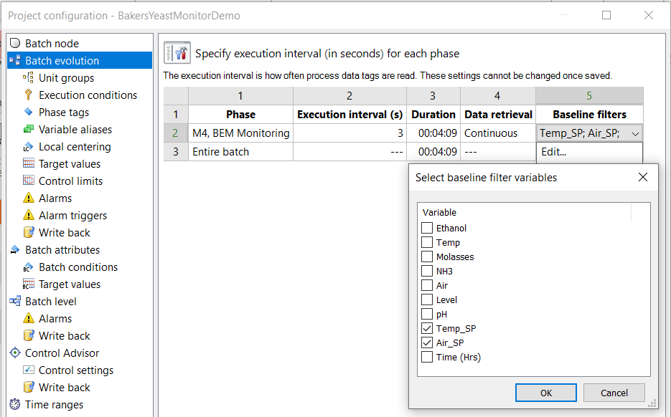
Baseline Filters to Combine IPC and Process Data
SIMCA®-online 17 News
Benefits
  It is possible to combine less frequently sampled IPC* data with process data with baseline filters.
Applies to
  SIMCA®-online system
Change
  IPC data can be treated as continuous data using baseline filters.
  Values for variables in the beginning of the phase are sampled but are now set to missing by SIMCA®-online.
  The assumption is that when the values change, they belong to the phase.
* IPC – In-Process Control

Slide 41
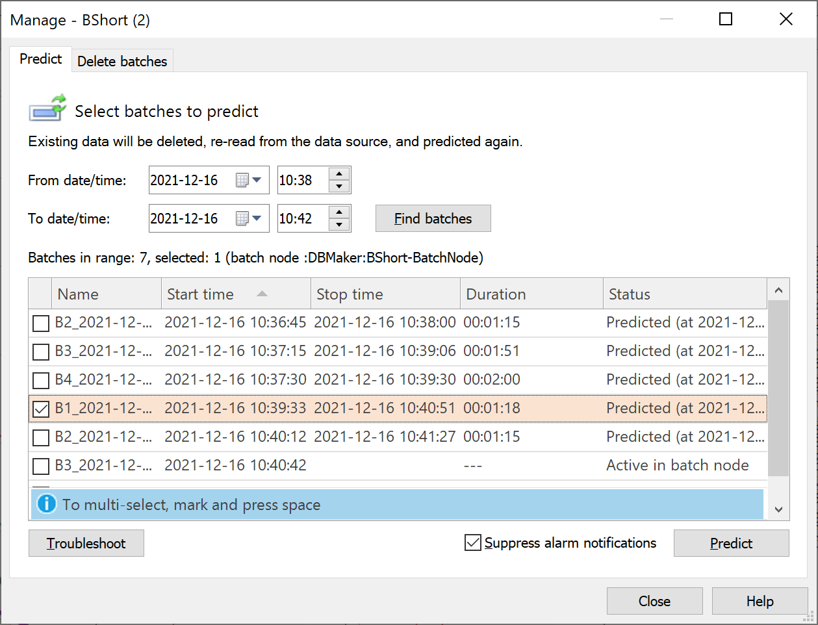
Suppress Alarm Notifications During Predict of Past Batches
SIMCA®-online 17 News
Benefits
  Situation based notifications
Applies to
  SIMCA®-online system
Change
  Default in SIMCA®-online 17 is to not send notifications during re-predict, with an option to turn them on.
  In previous versions of SIMCA®-online, notifications were always sent for triggered alarms when predicting past batches.
  Alarm notifications are not sent out during re-predict, when they are determined to be of limited value.

Slide 42
SIMCA®-online 16.1

Slide 43
SIMCA®-online 16.1
2020-03-31
News
Reset alarms in the Web Client
Troubleshooting for continuous project configurations
External libraries for Python pre-processing
Permissions granted to groups (replaces previous use of roles)
  Adds more flexibility to permissions
  More granular permissions of what users can do
Faster load time of client workspaces
Regular expression matching in phase execution conditions
Smaller fixes
Maximize button in all client panes
All active directory users can now be listed and imported where previously a subset was used
Bug fixes
Batch plots that use color by is now colored correctly when opened from a workspace
File | Share Workspace by email attachment works even if the option for session workspaces is turned off

Slide 44
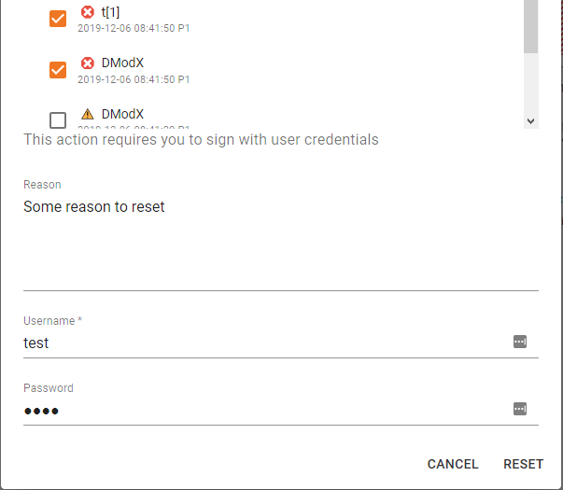
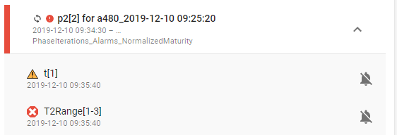
Reset alarms in Web Client
SIMCA-online 16.1 News
Benefits
  Web client can be used as a daily work tool to be compliant with 21 CFR part 11 (Electronic Signatures)
Applies to
  Web Client
Change
  Reset alarms with electronic signatures from several different locations in the web client
Informative reason for resetting the alarm

Slide 45

Troubleshooting improvement for continuous project configurations
SIMCA-online 16.1 News
Benefit
  Troubleshooting is easier to do and lets users find answers themselves instead of the need to contact the online support
Applies to
  Continuous projects/processes
  (Same functionality for batch projects was released with SIMCA-online 16.0)
New functionality
  Administrators can use the built-in troubleshooter on the Administration tab
  Verifies configuration and tag validity

Slide 46


External libraries for Python pre-processing
SIMCA-online 16.1 News
Benefit
  Scripts running math calculations run faster than without the SciPy or NumPy libraries
Applies to
  USP files with Python pre-processing
Change
  Preprocessing scripts now support code dependent on the Python libraries NumPy (1.15.4) and SciPy (1.1.0)
    These are standard packages for doing math on multidimensional data

Slide 47
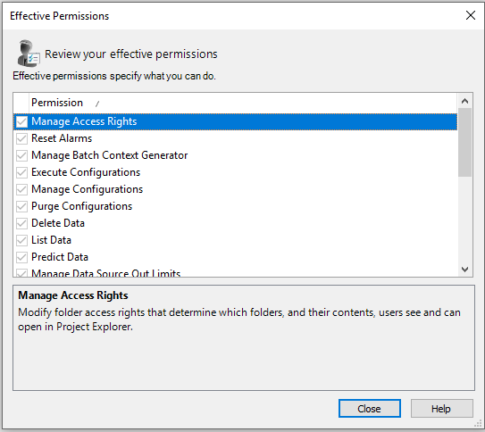
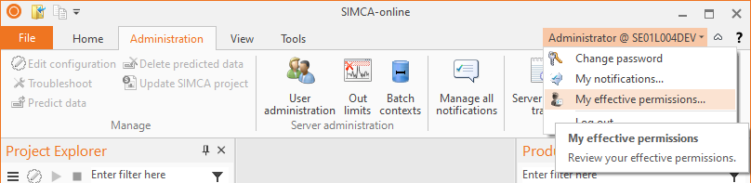
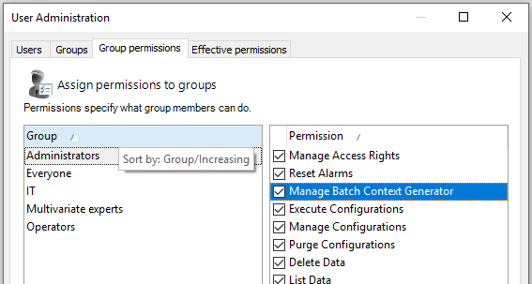
Permissions granted to groups (replaces previous use of roles)
SIMCA-online 16.1 News
Benefits
  Easy management of users and permissions
Applies to
  Server user authorization
Change
  Permissions are granted to groups
  Roles have been removed, and will migrate to groups when upgrading the system
  Final permissions is the union of all the permissions for all groups that the user is a member of
  Each user can see their own effective permissions
  Administrators can see effective permissions for any user
  The “Everyone” group will affect all users
  Permissions are more granular

Slide 48
Faster load time of client workspaces
SIMCA-online 16.1 News
Benefits
  Start-up of clients is about 30% faster
  Loading a server workspace is about 30% faster
Applies to
  Desktop client workspace
Change
  Performance of workspaces have improved

Slide 49

Regular expression matching in phase execution conditions
SIMCA-online 16.1 News
Benefits
  Allows execution of phases with a regular expression instead of plain text comparisons
Applies to
  Batch configurations
Change
  Phase execution conditions has now support for regular expression matching using the Match function
Tip: if you want to test regular expressions a great tool is https://regex101.com/

Slide 50
SIMCA®-online 16

Slide 51
SIMCA®-online 16
2019-11-26
Server
SIMCA® 16
Late entry data
Monitor excluded variables
Python script pretreatment
Administrable notifications
Bug fix: Server unresponsive when batch contexts were used in combination with notifications and other subsystems
Bug fix: Server shutdown was not correctly performed
Desktop client
Panes and Filters
  Project explorer pane
    Improved usability
    Smart filters
    Multiselect
  Unit overview pane
    View and open projects that are currently executing
    Smart filters
    Performance improvement
  Production overview pane
    Global batch selection
    Batch colors
    Find and retain historical batches
    Include workset batches
    Smart filters
  Properties pane
    Plot properties for active plot
Peek value of tags in configuration
Clamping
Web client
Comparison between production
  Search server for historical batches
  Multiple data vectors
  Easy add/remove vectors and batches
  Multiple Y-axes
System overview and Batch timeline
Batch level charts with alarms
Alarm view
Clamping

Slide 52


Late entry data
SIMCA-online 16 News – Server
Applies to
  At-line/IPC/discrete data
  CQA/batch condition data
New functionality
  Wait for and read data that exists after batches have finished producing
  Look for data at a configurable time interval
Benefits
  Enables SIMCA®-online to be used as CPV tool together with Active Dashboard
Feedback by the system to the user
  Information about an ended batch that is kept alive in the production overview

Slide 53

Monitor excluded variables
SIMCA-online 16 News – Server
Applies to
  Continuous projects/processes
  (Same behavior for batch projects exists as a work-around; see relevant KB article for more information)
New functionality
  Makes it possible to view variables that are imported to the SIMCA® project, but excluded from the model
Benefits
  Visualizing variables that are not and should not impact the model is now a lot easier

Slide 54



Python pretreatment
SIMCA-online 16 News – Server
Applies to
  All project files created in SIMCA®
New functionality
  Python scripts added to SIMCA® project files as pretreatment step will also be utilized by SIMCA®-online
Benefits
  Combine your own mathematics in Python with your multivariate models
Disclaimer
  First version is not thread safe
    Recommended to run only one python script per server
    First version does not support external libraries

Slide 55


Administrable notifications
SIMCA-online 16 News – Server
Applies to
  Desktop client
New functionality
  Active Directory not required
  Email addresses can be edited
  View logged in user's notification in My notifications
  View all notifications in Manage all notifications
    Admin tab
  Updated and grouped subscription dialog
  Requires users to reconfigure notifications for SIMCA®-online 16
Benefits
  Versatile usage of the notification system

Slide 56




Panes and filters
SIMCA-online 16 News – Desktop client
Project explorer pane
  Improved usability
  Smart filters
  Multi-select
Unit overview pane
  View and open projects that are currently executing
  Smart filters
  Unit overview performance
Production overview pane
  Global chart interaction
  Batch colors
  Find batches, retained if selected
  Workset batches
  Color by batch attribute data for classification
Properties pane
  Plot properties for active plot moved to pane

Slide 57

Panes and filters
SIMCA-online 16 News – Desktop client
Project
explorer
Production
overview
Unit
overview
Properties

Slide 58


View most current data per variable
SIMCA-online 16 News – Desktop client
Applies to
  Project configuration
New functionality
  Peek data for any data source tag
Benefits
  When specifying execution conditions
  When specifying batch identifier tags
  When connecting the right tags to model variables

Slide 59


Clamping
SIMCA-online 16 News – Clients
Applies to
  All charts
  Both clients
New functionality
  Normalize the Y axis in the charts by forcing the range to be normal
Benefits
  Spikes in the data will no longer resize the y-axis thus hiding the normal varying data

Slide 60




Compare batches and production
SIMCA-online 16 News – Web client
Helps engineers with daily tasks
  Comparison between batches
    Multiple Y-axes
    Search server for historical batches
    Multiple data vectors
    Easy add/remove vectors and batches
  Batch level charts

Slide 61


Responsive layout
SIMCA-online 16 News – Web client
View adopts to screen size

Slide 62

System overview and Batch timeline
SIMCA-online 16 News – Web client
Applies to
  Web client batch production
New functionality
  Overview summary for production, units and alarms
  Batch timeline which shows alarms and production time
Benefits
  Starting point for engineers to know where to start investigate and optimize the process

Slide 63
Summary of minor news
SIMCA-online 16 News
Server
  Audit trail audits workspace changes
  New BioPharma demo project
  Batch conditions are now optionally read more frequently
  Performance improvement by reducing the data source communication, and retrieving larger pieces of data when possible
  Project configuration is automatically checked for validity
  Bug fix: Dynamic lags sometimes gave missing value
Desktop client
  Modern tab control
    Additions; Icons, short text, single row, one tab/plot
    Removals; server tab for extracted lists and audit trails, alarm state colors
  Project explorer
    Simplified toolbar
    Open configurations/Server
      Alphabetical order
      Bold configuration means it is active
    Double click opens the config
      To update configuration – Right click
    Right click to get context menu
      Multiselect enabled
      New properties item
  Home tab
    Shortcuts to panes
    Removed properties from batch mode
  Configuration
    Time ranges moved and redesigned
  Smaller default plot symbols
Web client
  Progress bar when loading data
  New toolbar
  System overview is the new home/start page after log-in
  Plot improvements
    Batch selection list to quickly find what to plot
    Go from evolution to batch details in one click
    Change trend vectors with chips
  All batches are kept per session
  Responsive layout
  Bug fix: New data (“ticks”) reset zoom, and hidden limits

Slide 64
SIMCA®-online Older

Slide 65






SIMCA®-online 15.1
2018-09-12
Web client support of continuous process’
Restarted monitoring resumes execution from where it left off
Completed batch persists its information if shut down as default
Warning and Critical alarms are now treated individually
Rolling view loops over running configurations
Temporary loss of connection for batch processes sustains execution until connection is returned
Dynamic lags supported
Notes:
Supports models from SIMCA® 15.0.2

Slide 66
SIMCA®-online 15.0
2017-11-21
Automatic model creation
  Guide to create new batch models in SIMCA®-online
  Guide to create new continuous models in SIMCA®-online
Batch context generator
  Automatically create data driven batch contexts
  Inspect batch contexts in configuration
Data exploration
  Color/size by for all charts
  Multiple Y axes
  Guide to select tags to start monitor in SIMCA®-online
Notification system
  Email alarms subscription
  Windows event log notification
Operators web client
  Connect to the server from a web client and visualize typical batch evolution data
Phase iterations
  Support phase iterations
Soft reset of alarms
  Batch condition target value alarms
  Continuous process alarms now retriggers after system are back in control
General
  Batch attributes (secondary IDs) available for color/size by
  Batch node advanced filters
  High DPI compatible
  Create workspace role permission added
  Prediction of workset batches allowed
  Production overview filter box

Slide 67
SIMCA®-online 14.0
2015-12-10
Active Directory integration and Single Sign-on
Control advisor for continuous and multi phase projects
Update project workflow
Web API connectivity
OPLS models for Batch Evolution Plots
Last views are stored in local workspace
Unit overview
Color by and size by for continuous processes
Share screenshots or workspaces through mail
Notes:
Smaller features
Unselect SimApi to start server with (instead of remove)
Sources of variation plot for batch level drill down
Observed and predicted plot in batch level
Limits on batch level batch conditions
Responsiveness improvements
Back-stage
Register and visualize who reset an alarm or created a note
Added unit to filter in the alarm report
Removed not configured units from the production overview
Unicode, meaning that it will work better with global interaction
EWMA filter now use the filter version of EWMA (no time delay)
Minimum increment changed to visualize errors in maturity
Batch level target value alarms
Batch level variable plot control limits

Slide 68
SIMCA®-online 13.x
SIMCA®-online 13.3 (2014-06-10)
  Control Advisor for batch forecasting and optimizer driven process control
  Performance and user experience improvements
SIMCA®-online 13.2 (2013-12-10)
  Discrete data retrieval for In-process control data
  SPC filters for Continuous processes
  Electronic signatures fully supported
  Active directory user import improvements
  Hierarchical model drill down for continuous processes
  Performance and user experience improvements
SIMCA®-online 13.1 (2013-05-31)
  Server audit trail
  Extended configuration audit trail
  Catch-up and repredict for continuous projects
  Control limits for variables in continuous projects
  User access control to configurations

Slide 69
Thank You.
Specifications subject to change without notice.
© 2025 Copyright Sartorius Stedim Data Analytics AB, Östra Strandgatan 24
903 33 Umeå, Sweden

